Slide 1
CONGREGATION AT THE CROSSROADS
Five Questions for a Challenged Church

Slide 2
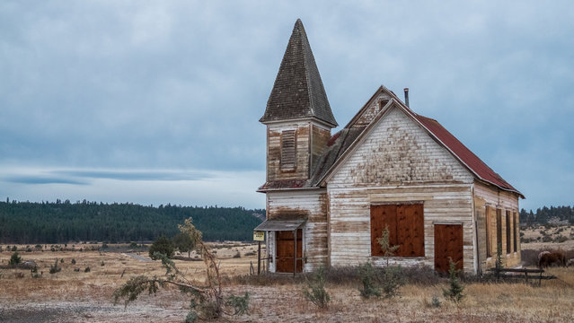
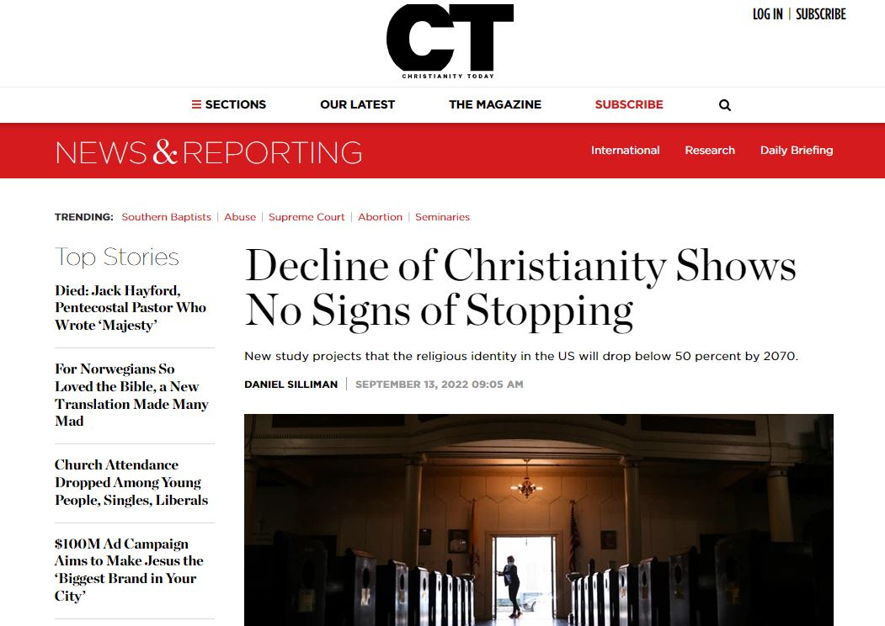
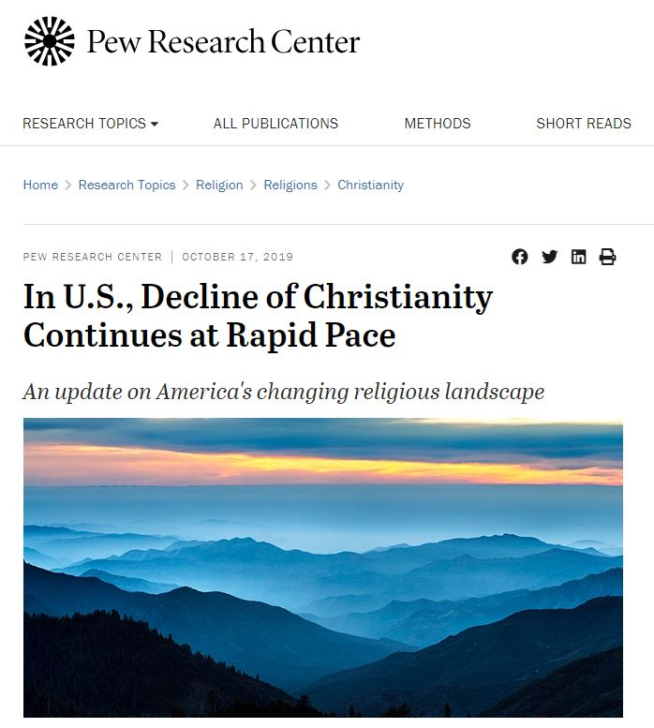
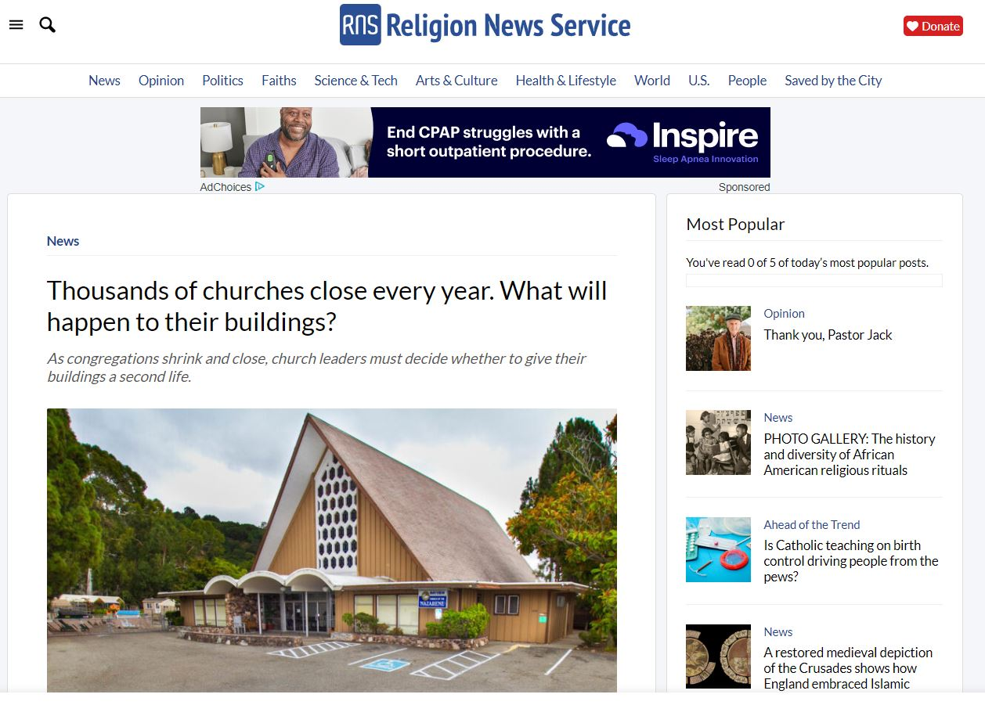
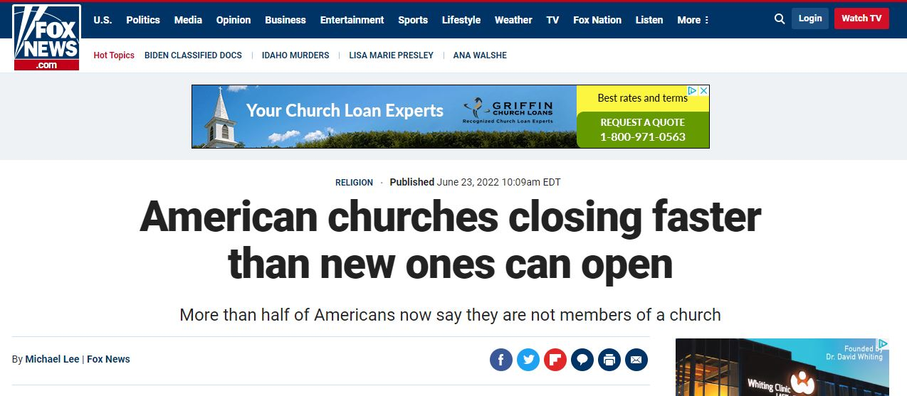
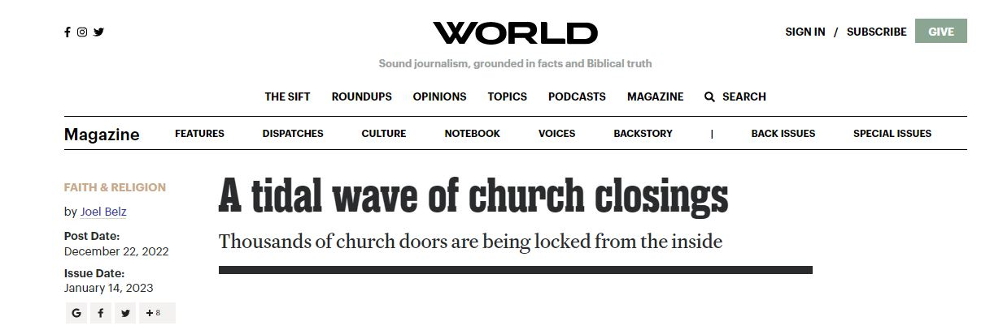
Currently in America, one Christian church closes every ninety minutes.

Slide 3
73%
55%
58%
44%
26%
27%
9%
10%
16%

Slide 4
Are we challenged?
A decline in total membership in seven of the past ten years
A decline in worship attendance for four straight years
A % decline in either membership or worship attendance in the past two years (10% for churches >100; 8% for churches <100).
If two out of three are present, then YES.
Notes:
You could look at cultural things obviously. Is the church inward focused, ignoring outreach? Does the church look like the community? Is there a culture of consumerism, where personal preferences is what drives ministry. However, the answers to those questions are somewhat subjective. These are more objective factors, because they’re rooted in statistics.

Slide 5
Where are we at in the challenge?
DENIAL
DELAY
DALLYING
DISPARAGEMENT
DEPARTURE
DESPERATION
DEATH

Slide 6
5Q
WHY?
WHO?
WHAT?
HOW?
WHERE?

Slide 7
Q1
Why do we care if our church is in decline?
WHY?

Slide 8
Is this all about…
my comfort
personal preference
the mission of the Church
the Commission
prayerful purpose
us / me
Jesus Christ
memories of this church
or
…?

Slide 9
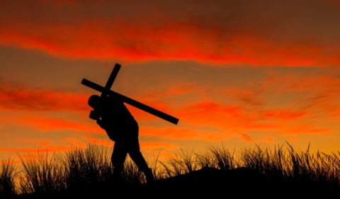
Timothy 3:2
People will be lovers of themselves…
Philippians 1:21
For to me, to live is Christ and to die is gain.
Notes:
Galatians 2:20
I have been crucified with Christ and I no longer live, but Christ lives in me. The life I now live in the body, I live by faith in the Son of God, who loved me and gave himself for me.

Slide 10
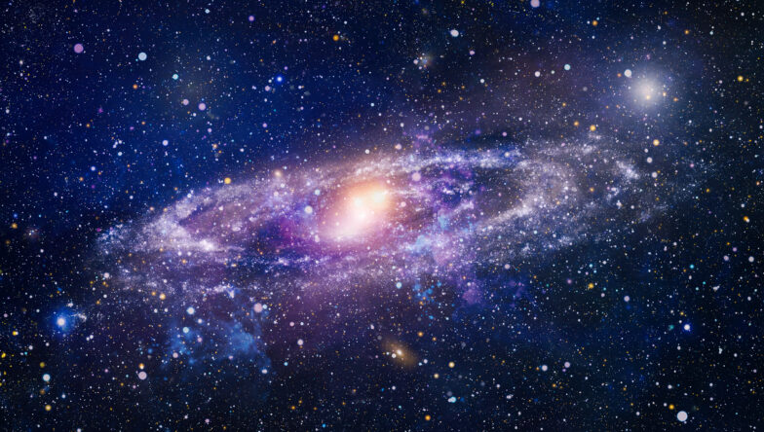
Colossians 1:15-18
¹⁵ The Son is the image of the invisible God, the firstborn over all creation. ¹⁶ For in him all things were created: things in heaven and on earth, visible and invisible, whether thrones or powers or rulers or authorities; all things have been created through him and for him. ¹⁷ He is before all things, and in him all things hold together. ¹⁸ And he is the head of the body, the church; he is the beginning and the firstborn from among the dead, so that in everything he might have the supremacy.

Slide 11
Q1
Why do we care if our church is in decline?
WHY?

Slide 12
Q2
Whom are we trying to reach?
WHO?

Slide 13
2 Corinthians 5:16-21
¹⁶ So from now on we regard no one from a worldly point of view. Though we once regarded Christ in this way, we do so no longer. ¹⁷ Therefore, if anyone is in Christ, the new creation has come: The old has gone, the new is here! ¹⁸ All this is from God, who reconciled us to himself through Christ and gave us the ministry of reconciliation: ¹⁹ that God was reconciling the world to himself in Christ, not counting people’s sins against them. And he has committed to us the message of reconciliation. ²⁰ We are therefore Christ’s ambassadors, as though God were making his appeal through us. We implore you on Christ’s behalf: Be reconciled to God. ²¹ God made him who had no sin to be sin for us, so that in him we might become the righteousness of God.

Slide 14
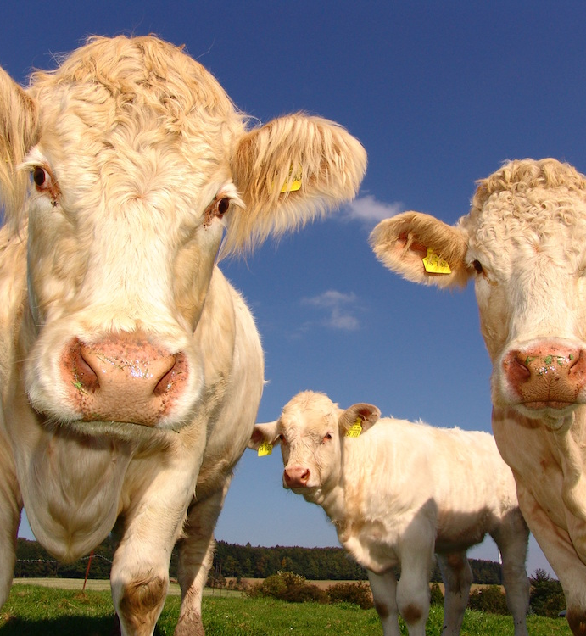
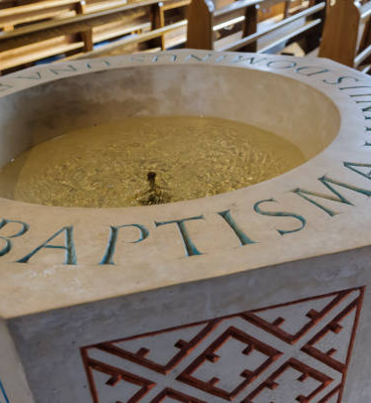

Slide 15
SIX TYPES OF UNCHURCHED AMERICANS
THE SHOPPER
THE DISENGAGED
THE TURNED OFF
THE HAPPY HUMANIST
THE ASSAILANT
THE UNEXPOSED

Slide 16
THE UNCHURCHED | 1980 | 2000 | 2020
THE SHOPPER | 33 | 22 | 5
THE DISENGAGED | 38 | 41 | 13
THE TURNED OFF | 13 | 16 | 20
THE HAPPY HUMANIST | 9 | 11 | 33
THE ASSAILANT | 6 | 7 | 11
THE UNEXPOSED | 1 | 3 | 18
71%
18%
28%
64%

Slide 17
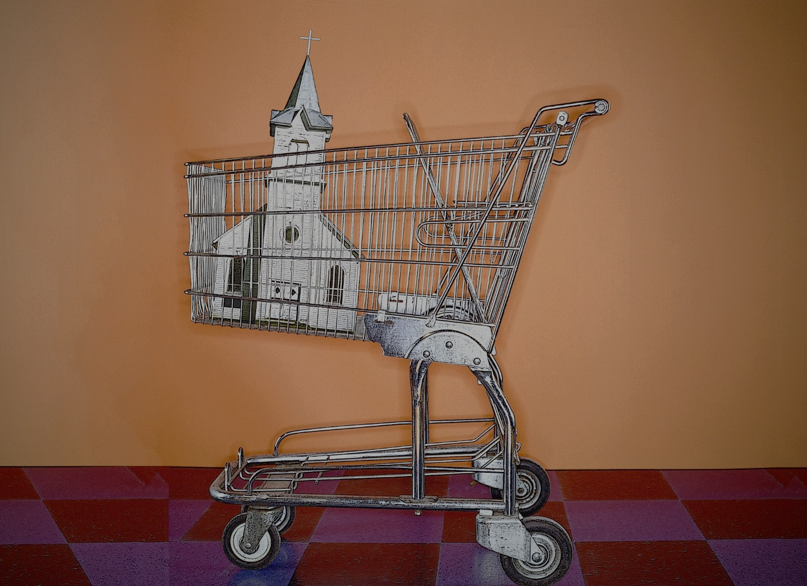
Better music: more contemporary / more traditional
Better facility / atmosphere: more laid-back / more formality
Better tech / HD screens everywhere
Better amenities (Starbucks instead of Folgers Crystals)
Better pastor / better preaching
Better programs for kids or teens or seniors or singles or women or men or seniors or pet owners or…

Slide 18
Whom does God love more?

Slide 19
Q2
Whom are we trying to reach?
WHO?

Slide 20
What am I personally willing to do for our mission effort?
Q3
WHAT?

Slide 21
Romans 12:12
Be transformed by the renewing of your mind. Then you will be able to test and approve what God’s will is—his good, pleasing and perfect will.

Slide 22
KEEP
The understanding that only the Holy Spirit can create faith
The realization that “success” in defined as doing all we can with the gospel, not in the outward growth of our church
FROM
TO
the mindset that we need to “get our church’s name out there” in the community
the mindset that we need to get our members out there into their community
thinking of evangelism as something that is relationship driven
thinking of evangelism as something that is program driven
primarily relying on personal witnessing and invitational evangelism
primarily relying on corporate outreach

Slide 23
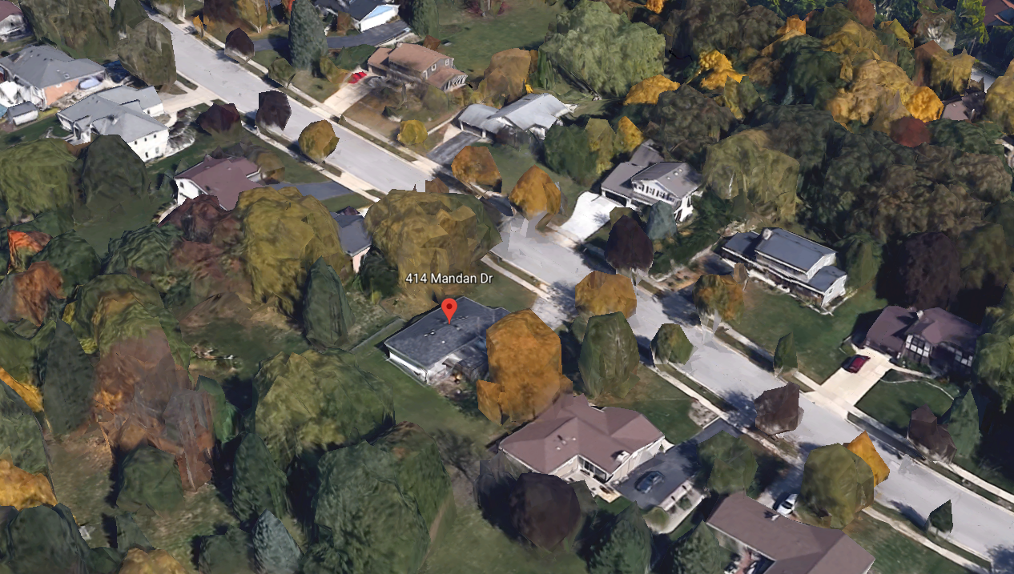
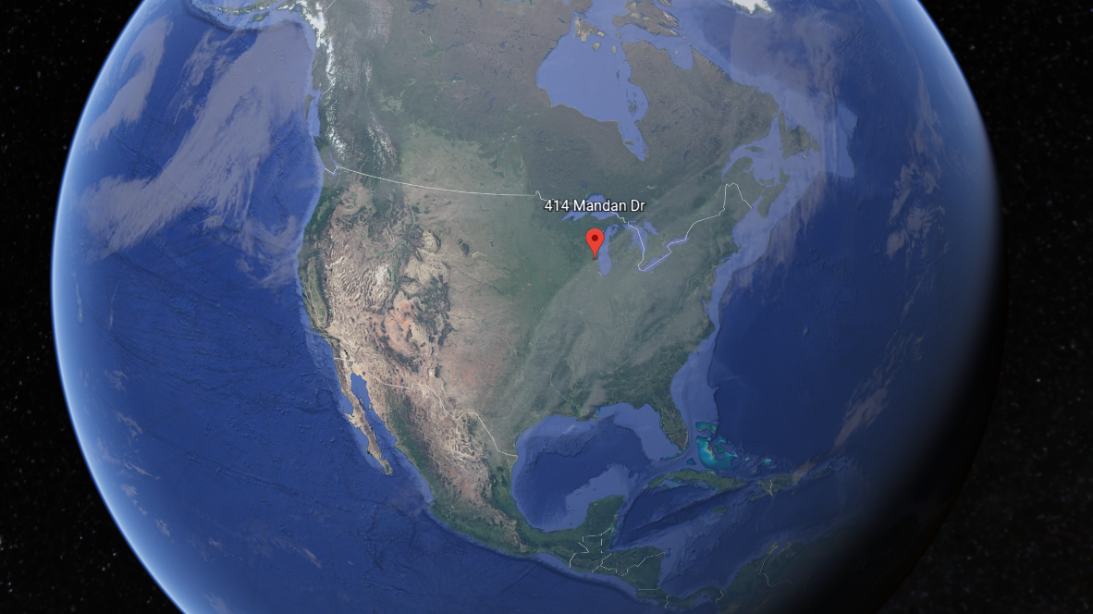
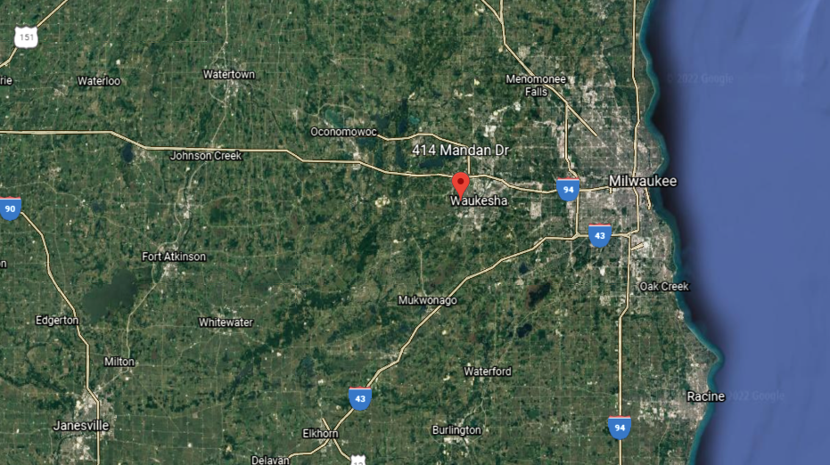
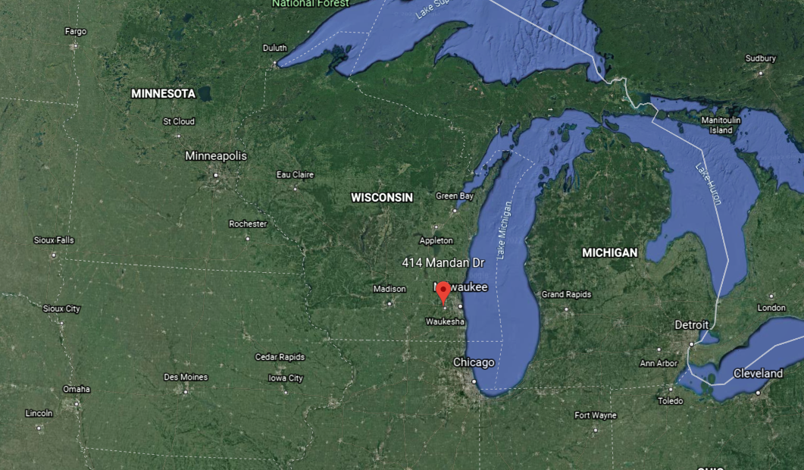
A THEOLOGY OF TIME & PLACE
ACTS 17:26,27
From one man he made all the nations, that they should inhabit the whole earth; and he marked out their appointed times in history and the boundaries of their lands. God did this so that they would seek him and perhaps reach out for him and find him, though he is not far from any one of us.

Slide 24
Hebrews 13:2
Do not forget to show hospitality (φιλοξενίας) to strangers.
Luke 16:9
I tell you, use worldly wealth to gain friends for yourselves…

Slide 25
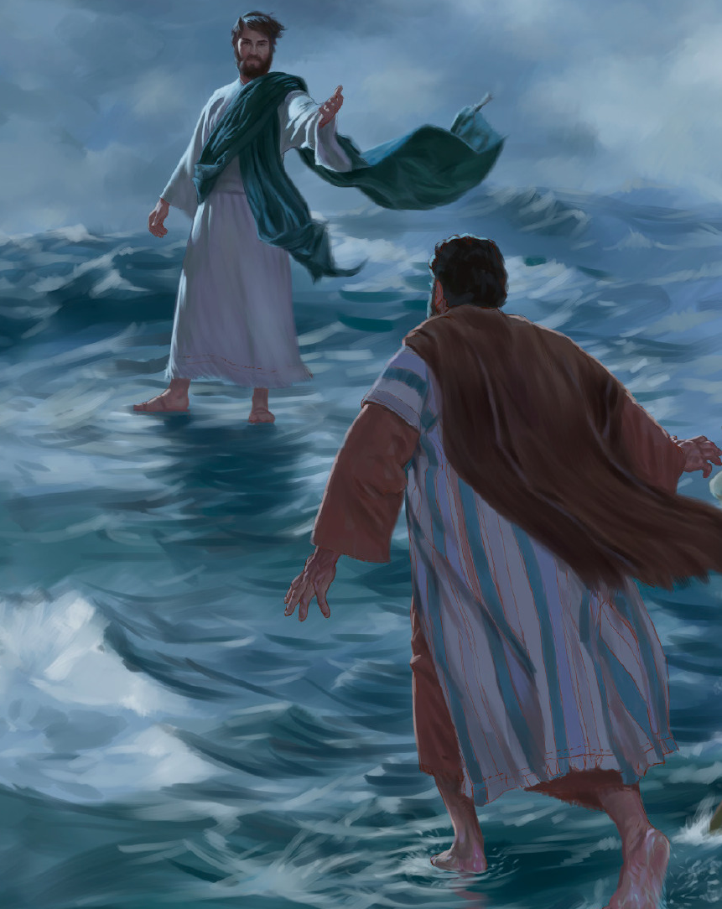
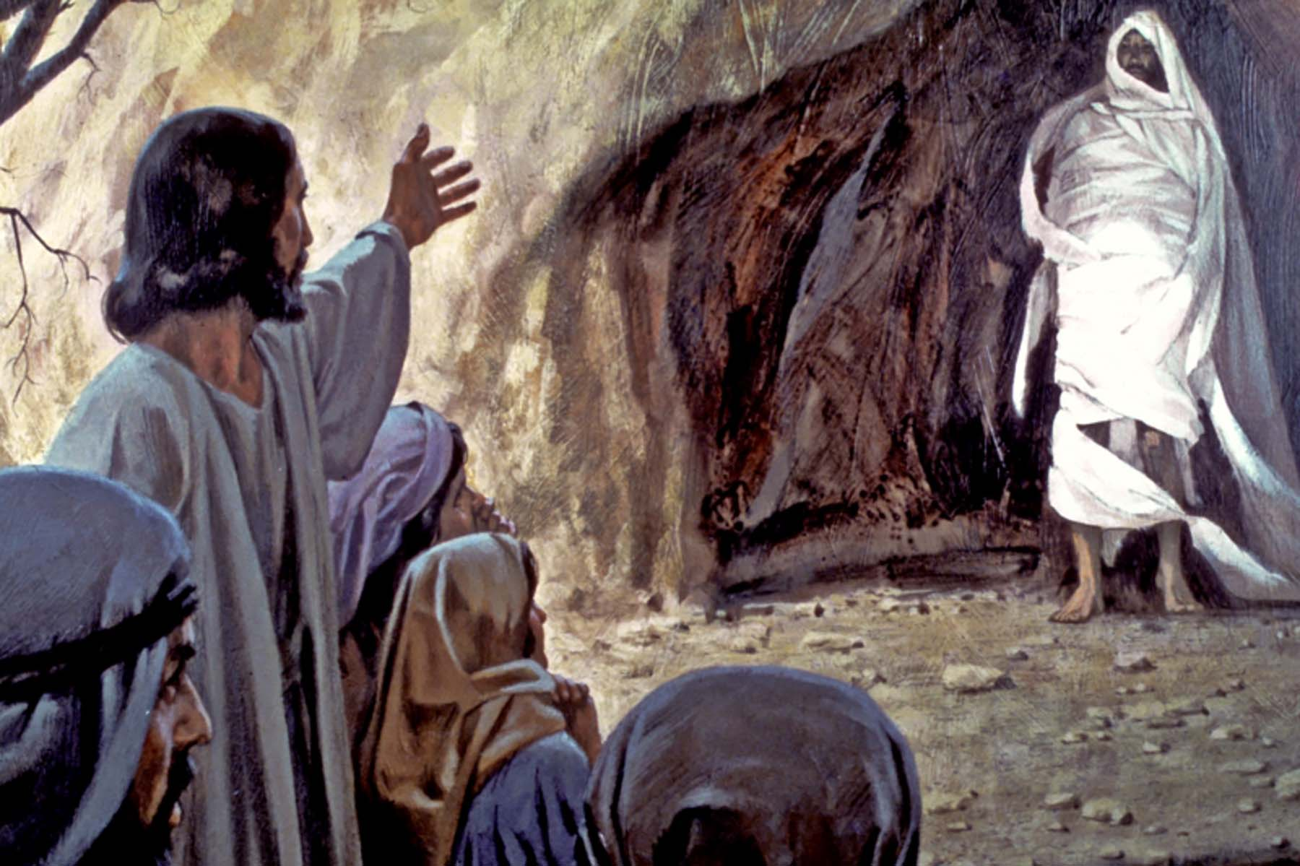
I’m just not wired this way. I’m too introverted.
This isn’t something for me.
Matthew 14:29
“Come,” Jesus said. Then Peter god down out of the boat [and] walked on the water…
John 11:43,44
Jesus called in a loud voice, “Lazarus, come out.” The dead man came out…

Slide 26
The Shadow of the Leader
If this is going to happen, we need leaders who are willing to lead by example.

Slide 27
FROM
TO
believing that to do evangelism, we need:
a large outreach budget
better _________
a preschool or some other program
understanding that to do evangelism, we need:
the Gospel
some neighbors
courage

Slide 29
What am I personally willing to do for our mission effort?
Q3
WHAT?

Slide 30
Q4
How do we assess our ministry efforts?
HOW?

Slide 31
A member puts in the time needed to develop a relationship with an unchurched neighbor.
As God provides the opportunity, that member shares how his faith in Christ is crucial in meeting all life’s challenges.
The member invites this new friend to come to church.
WHAT HAPPENS?

Slide 33
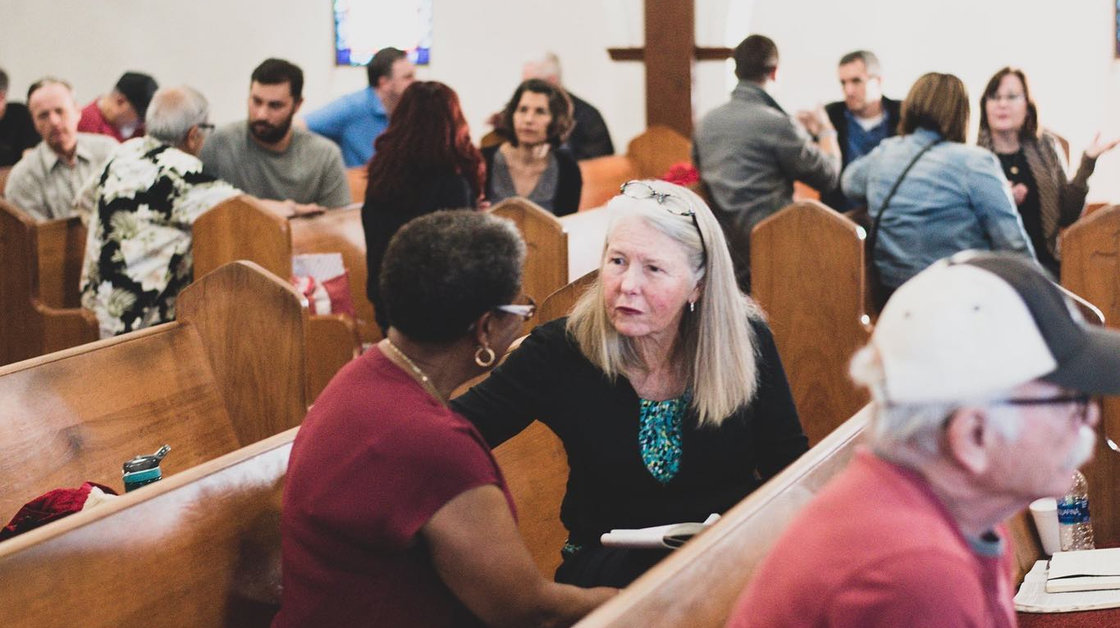
SUNDAY MORNING:
On a scale of 1 to 5, the importance that…
Law & Gospel is proclaimed off scale
the guest is well welcomed (not put off) 4 of 5
the guest can follow along and participate 4 of 5
(related: the music is well-done, regardless of instrumentation – 4 of 5)
the sermon touches their head and heart 5 of 5
(not necessarily that it makes them feel good / comfortable)
the guest is thanked later in the week 5 of 5

Slide 34
To assess your Sunday ministry efforts:
Consider asking some outsiders to serve as an anonymous “spy” and produce a written evaluation
Consider asking all worship guests to fill out a brief exit survey
Get enough data / feedback to have actionable information

Slide 35
THERE ARE VERY FEW MINISTRY ACTIONS THAT GOD’S WORD COMMANDS. SO EVALUATE EVERYTHING AND…
FEED THE TIGER. RIDE THE PONY. SHOOT THE DOG.

Slide 36
Q4
How do we assess our ministry efforts?
HOW?

Slide 37
Q5
Where do we pray this congregation goes in the future?
WHERE?
three options for the challenged church

Slide 38
OPTION ONE:
Ministry Redevelopment
OPTION TWO:
Congregational Consolidation

Slide 39
ABSORPTION MERGER
A
B
C
D

Slide 40
RELOCATION MERGER
A
B
E
C
D

Slide 41
MULTI-SITE MERGER
A
B
ONE CHURCH, MULTIPLE SITES
C
D

Slide 42
REBRANDING MERGER
Holy Cross
Word of Life
GRACE

Slide 43
WELS peak membership was 421,000 in 1990.
We have about 85,000 fewer members today.
Yet, we have a vacancy problem.
So, how many fewer pastors must we have today than we had in 1990?
A
100 to 200 fewer pastors
B
201 to 300 fewer pastors
C
more than 300 fewer pastors

Slide 44
Year
1990
2021
Total WELS Members
421, 396
340,511
Average Weekly Worshipers
193,747
107,441
Total Pastors
1,361
1,388
Total Congregations
1,221
1,250
Weekly Worshipers / Parish Pastor
163:1
90:1

Slide 45
In 2021, 44% of WELS congregations worshiped 50 or fewer (518 churches).
Many of those are within 10 minutes of a congregation in a similar circumstance.

Slide 46
THE MEANS & THE END
THE END
Christ. Christ’s glory. Christ’s mission.
THE MEANS
congregations & their ministry efforts
Therefore, the right question is not, “How many congregations does WELS have?” The right question is, “How can we best conduct ministry to impact the most people?”

Slide 47
OPTION ONE:
Ministry Redevelopment
OPTION TWO:
Congregational Consolidation
OPTION THREE:
Reallocation & Resurrection

Slide 49
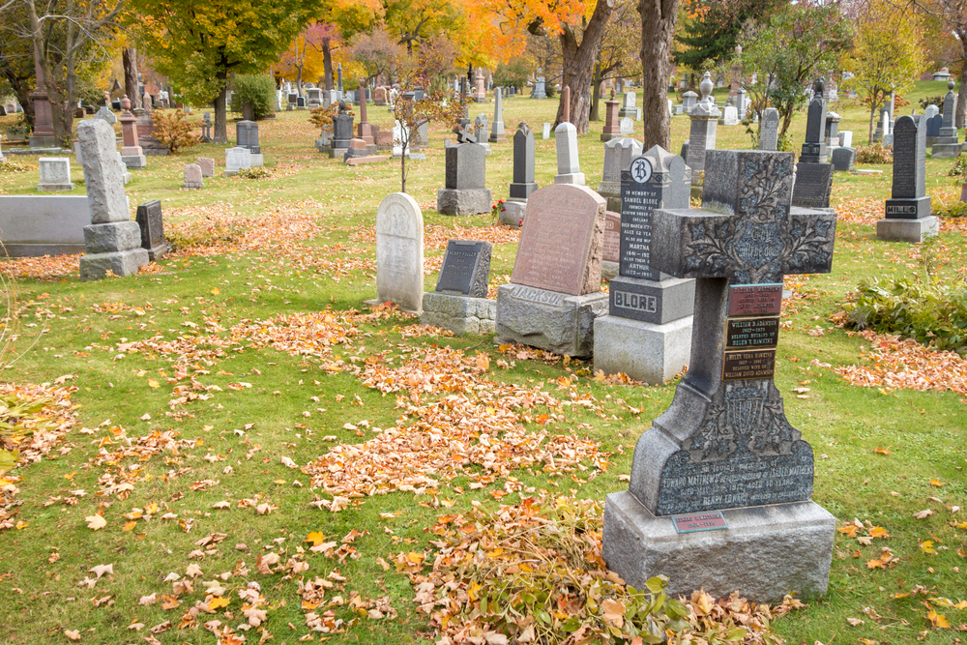
In Christ’s Church, there really isn’t such a thing as death.

Slide 50
CONGREGATION AT THE CROSSROADS
Five Questions for a Challenged Church

