Slide 1
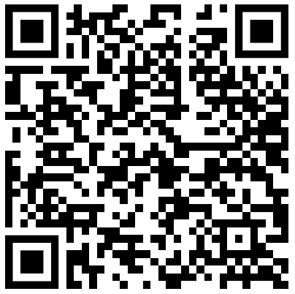
OPENING MINDS TO CLOSING THE FUNDING GAP
Addressing the Financial Sustainability of WELS Schools
Paul R. Patterson
January 2023
Notes:
Congregational Services Division
Addressing Needs of Churches and Schools
Highest pain points

Slide 3
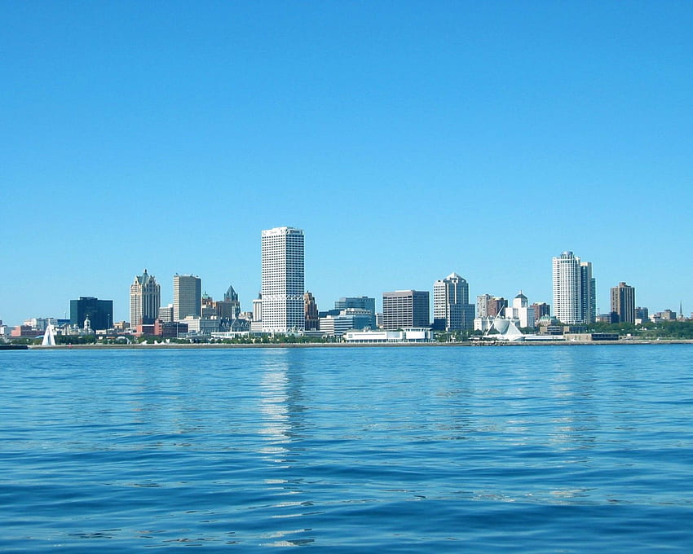
Form a group of 4 (assign each person a number 1 through 4)
Name
Where you serve?
How long you have served there?
In what capacity do you serve?
What is the largest body of water on which you have boated?

Slide 4
Open Minds Closed Funding Gap
AGENDA
Examine the Current Reality
Interact with Stats
Explore Options
Tackle the Change
LEWIN
ADKAR
Notes:
Share Change management Theory info:
Kurt Lewin developed the change model as a way to illustrate how people react when facing changes in their lives. The three stages of this process include unfreezing (the person has an existing state), moving or changing towards new ways of being, and then refreezing into a new state altogether!
In the unfreeze state, organisations that are changing need to ensure strong support exists. If not, they need to show the need for the change. Support the people through the doubts and concerns that will follow
The word “ADKAR” is an acronym for the five outcomes an individual needs to achieve for a change to be successful: Awareness, Desire, Knowledge, Ability and Reinforcement. The model was developed nearly two decades ago by Prosci founder Jeff Hiatt after studying the change patterns of more than 700 organizations.
Examine the Current Reality
set the statistical stage
What does this Mean?
Jigsaw key survey questions
Explore Options
What solutions exist in the marketplace
Tackle the Change
Lead your ministry through a reexamination of your practice

Slide 5
Lost at Sea
Rank the 15 items in terms of importance as you wait to be rescued. Place a 1 by the most important item, a 2 by the next most important, and so forth until you have ranked all 15 items.
Notes:
Chartered a yacht with three friends. Mid Atlantic a fire breaks out. Captain and crew are lost fighting the fire. You and your friends survive in a four person life raft a box of matches and the following 15 items

Slide 6
In calm water every ship has a good captain. Rough waters are truer tests of leadership.
— Swedish proverb

Slide 7
Metaphor for Past Congregational Change Efforts
Smooth Sailing Women and Children First
Where would past change efforts in your congregation be placed on this continuum and why did you place it there?

Slide 8
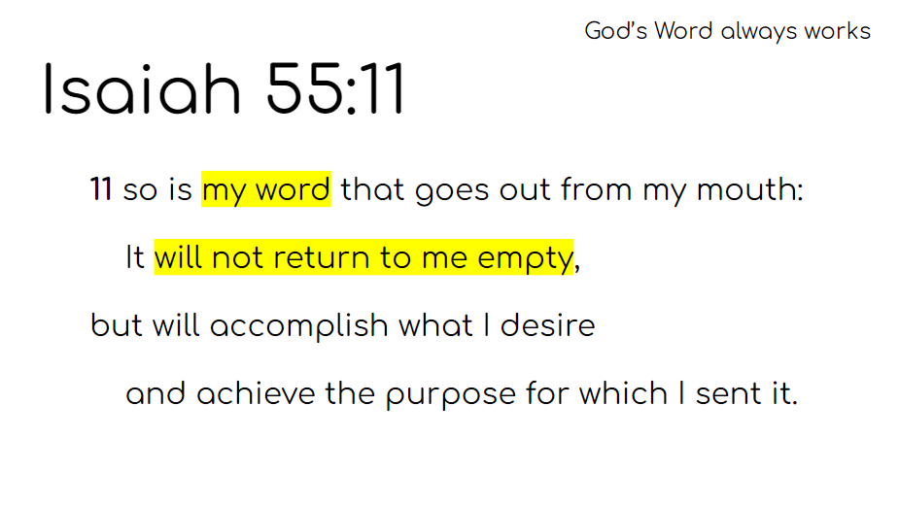
Courtesy of Seth Fitzsimmons St Paul Muskego

Slide 9
Open Minds Closed Funding Gap
Current
Many schools are underfunding their programs because of low tuition and high demands on church contributions
LEWIN
ADKAR
Notes:
Share Change management Theory info:
Kurt Lewin developed the change model as a way to illustrate how people react when facing changes in their lives. The three stages of this process include unfreezing (the person has an existing state), moving or changing towards new ways of being, and then refreezing into a new state altogether!
In the unfreeze state, organisations that are changing need to ensure strong support exists. If not, they need to show the need for the change. Support the people through the doubts and concerns that will follow
The word “ADKAR” is an acronym for the five outcomes an individual needs to achieve for a change to be successful: Awareness, Desire, Knowledge, Ability and Reinforcement. The model was developed nearly two decades ago by Prosci founder Jeff Hiatt after studying the change patterns of more than 700 organizations.

Slide 10
KEY FINDINGS: SWOT
Schools often dismiss business models when making financial decisions
Schools have what parents are seeking
Strengths Weaknesses
Notes:
After you have defined a problem a SWOT analysis guides you to identify and build on what you do well, address what you're lacking, seize new openings, and minimize risks.
SWOT analysis of WELS schools reveal that despite being financially malnourished, we have what parents are seeking:
Strong Academics
Positive School Climate
Traditional Values
Address Spiritual Needs
Manageable size

Slide 12
KEY FINDINGS: SWOT
Public funding removes the tuition barrier for families
Public funding comes with government strings attached
Political:
School Choice
COVID Financial programs offer additional monies that offset some of the inflationary challenges
Inflation doesn’t just drive-up prices; it also strains donors
Economic:
Inflation
Critical Theories are creating a larger market for values-based schools
Social:
Critical Theories
Strained social climate creates tensions between private and public schools
Technology opens many opportunities to enhance educational programs
Technological:
Online Education
Technology creates another competitor in the education marketplace
Opportunities
Threats
Notes:
To evaluate the opportunities and threats, I used a modified PESTLE analysis.
The Key Findings in the Political Economic, Social and Technological analysis can be represented as both opportunities and threats.
For example: School choice impacts our schools. While it removes tuition as a barrier for enrollment, strings are always attached to government money.

Slide 13
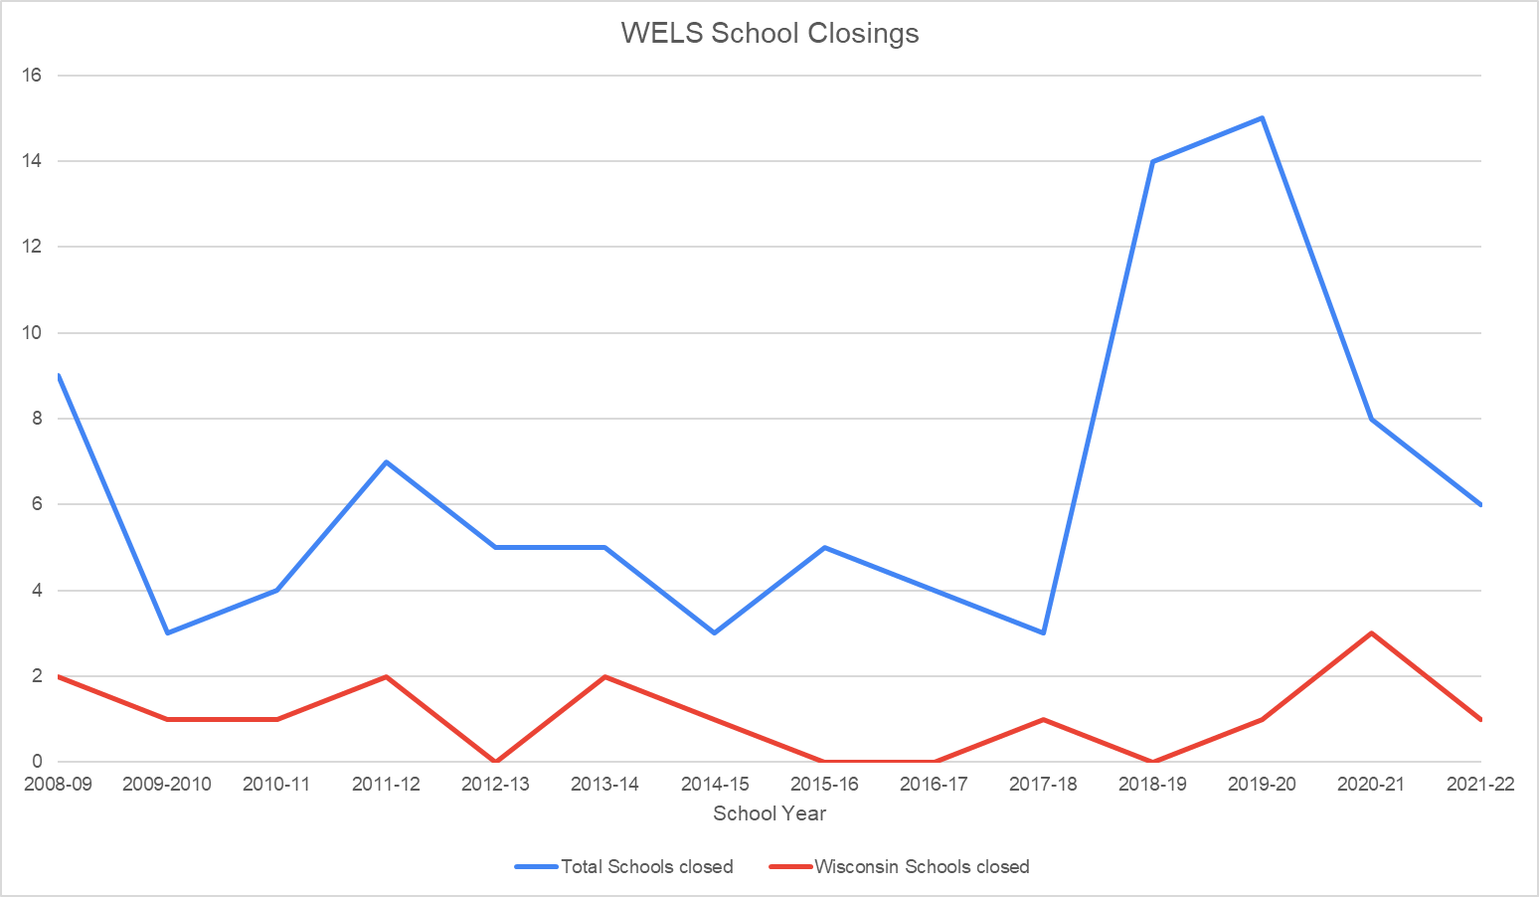
70%
75/52
1995 – 402 – 31,000+
2022 – 284 – 27,000+
WELS
Lutheran
Schools
Notes:
28 years ago when I began teaching, WELS LES schools were at their high water mark
Today, we have 30% fewer schools and 13% fewer students
70% of schools closed since 2015 – lack of funds or lack of students
75% charge rates that are less that ½ of the cost to educate a student
Over Half of our schools charge less than $10/day for a Christian Education
(1 in 5 charge less than $5 a day)

Slide 14
ROOT CAUSE ANALYSIS
Why are schools closing down?
Why don’t they have enough students?
Why aren’t parents seeing the value?
Why aren’t schools implementing better programs/vision/ministry plan?
Why don’t they have enough money?
Why don’t they explore a different funding model?
Why are people attached to the current model?
Why do they believe that people won’t pay more?
FIVE (Eight) WHYS
Notes:
Why are schools closing down? They don’t have enough students
Why don’t they have enough students? Parents aren’t seeing the value
Why aren’t parents seeing the value? Schools aren’t offering compelling programs/vision/ministry plan
Why aren’t schools implementing better programs? They don’t have the money
Why don’t they have enough money? Current funding model is tapped out
Why don’t they explore a different funding model? Attached to this one or aren’t aware of options
Why are people attached to the current model? Don’t believe people will pay more
Why do they believe that people won’t pay more? Culturally we don’t want to price anyone out of a Christian education

Slide 15
ROOT CAUSE ANALYSIS
Why are schools closing down?
Why don’t they have enough students?
Why aren’t parents seeing the value?
Why aren’t schools implementing better programs/vision/ministry plan?
Why don’t they have enough money?
Why don’t they explore a different funding model?
Why are people attached to the current model?
Why do they believe that people won’t pay more?
FIVE (Eight) WHYS
Notes:
Why are schools closing down? They don’t have enough students
Why don’t they have enough students? Parents aren’t seeing the value
Why aren’t parents seeing the value? Schools aren’t offering compelling programs/vision/ministry plan
Why aren’t schools implementing better programs? They don’t have the money
Why don’t they have enough money? Current funding model is tapped out
Why don’t they explore a different funding model? Attached to this one or aren’t aware of options
Why are people attached to the current model? Don’t believe people will pay more
Why do they believe that people won’t pay more? Culturally we don’t want to price anyone out of a Christian education

Slide 16
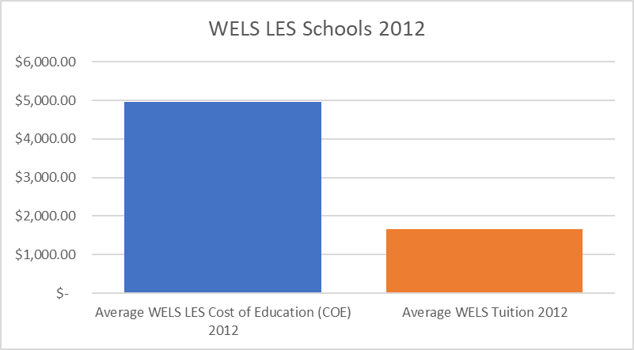
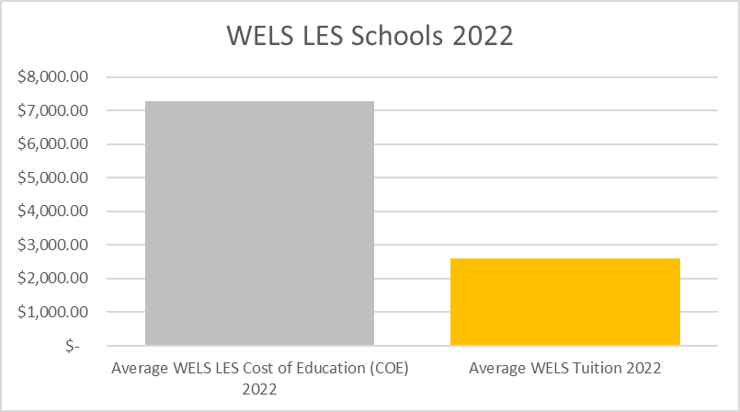
Cost of Education 47% increase
Average Tuition 57% increase
Inflation 30.17% increase
Tuition covers roughly ⅓ of the cost to educate

Slide 17
“The traditional Lutheran view of the relationship of member churches to sponsoring Pk-12 schools has been to subsidize, often deeply, the tuition costs of the congregational members who attend the school. In many parts of America, it is not uncommon for so called “member tuition” rates to be a third of [the cost].”
Grace Works Ministries: Towards a Lutheran Theology of Tuition and Financial Aid for Christian Schools

Slide 18
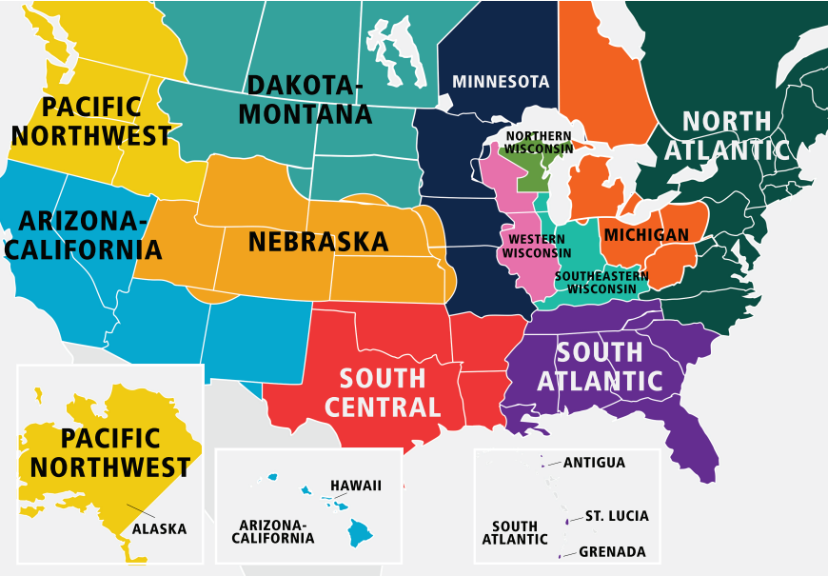
COE = Cost of Education
in the fall ‘22
COE - $6,185
Tuition - $2,616
COE - $8,551
Tuition - $7,178
COE - $6,691
Tuition - $2,031
COE - $5,333
Tuition - $3,798
Northern WI
COE - $6,208
Tuition - $1,447
Michigan
COE - $5,523
Tuition - 1,867
COE - $6,079
Tuition - $2,741
COE - $7,201
Tuition - $5,570
COE - $9,498
Tuition - $8,111
Western WI
COE - $6,268
Tuition - $1,579
Southeastern WI
COE - $7,272
Tuition - $2,108
South Atlantic
COE - $7,262
Tuition - $7,554

Slide 19
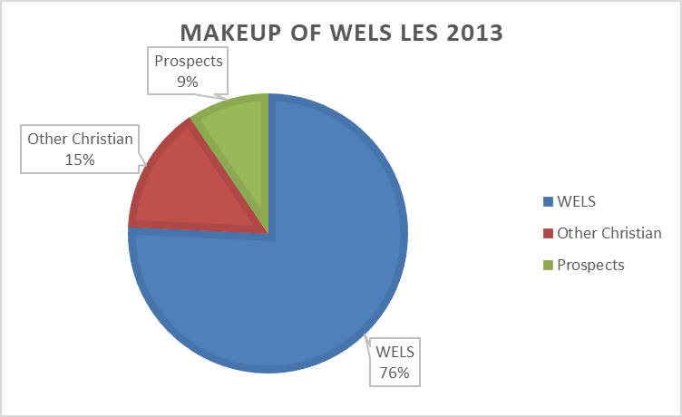
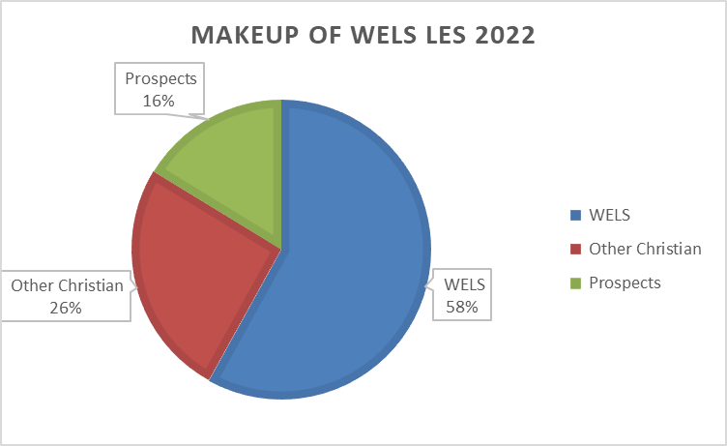
Total Students in WELS LES 28,179
WELS Students in WELS LES 16,355
Students from other Christian Churches 7,234
Prospect Student in WELS LES 4,590
Total Students in WELS LES 28,179 (+4,000)
WELS Students in WELS LES 16,355 (-1,949)
Students from other Christian Churches 7,234 (doubled!)
Prospect Student in WELS LES 4,590 (doubled!)
Notes:
Stewardship - 51/285 =18% Charge Other Christian/Prospect Students full cost

Slide 20
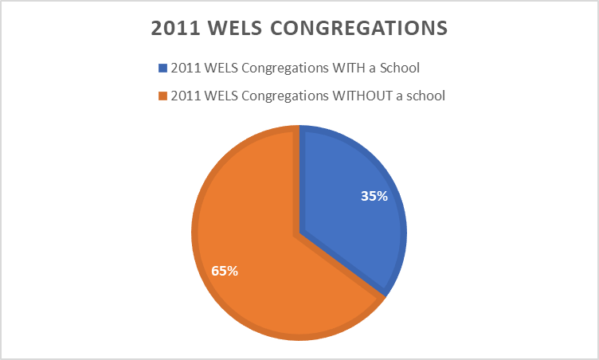
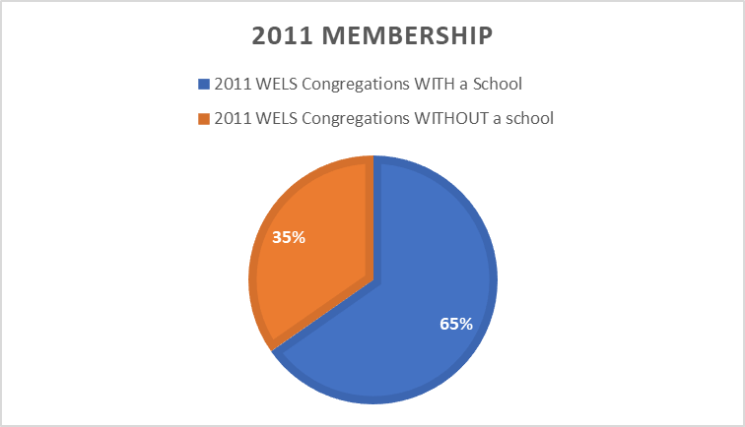
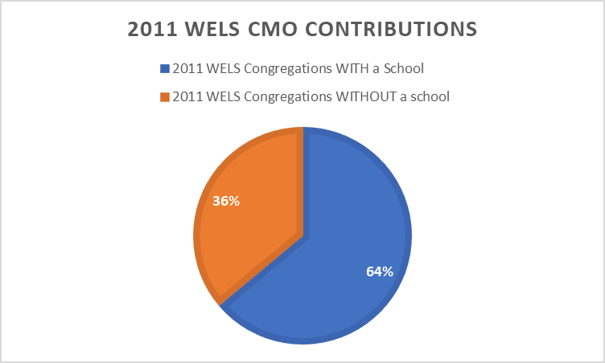
402
282,547
741
121,649
⅓ of the Congregations have schools and
have ⅔ of the members and contribute ⅔ of the CMO
$12.3 million
$7 million

Slide 21
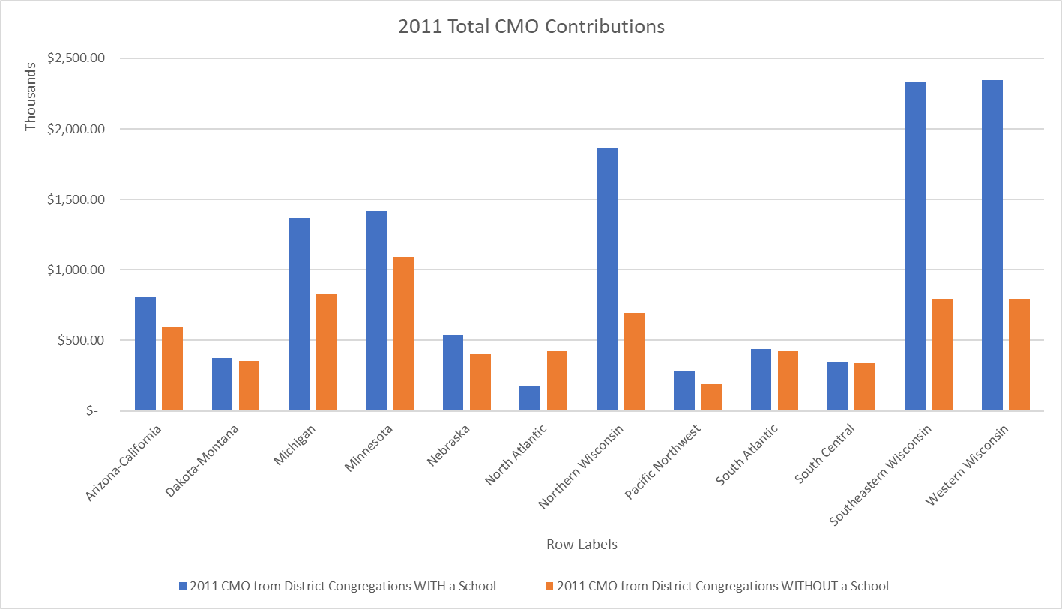
67
60
57
45
52
87
29
101
64
82
70
63
28
10
59
56
37
26
47
7
33
15
28
6

Slide 22
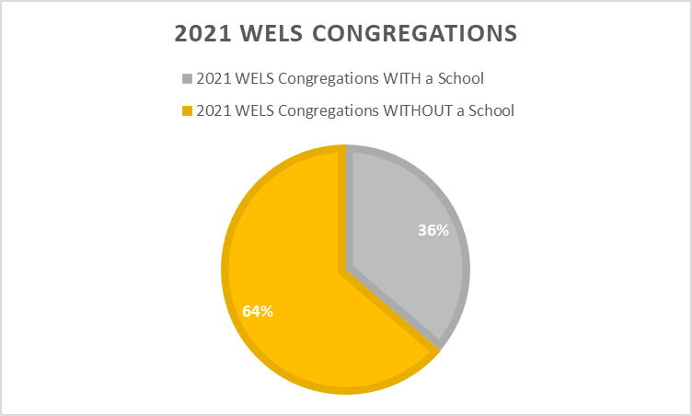
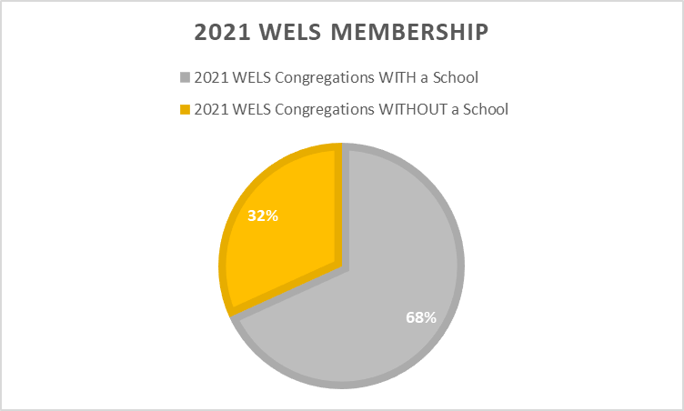
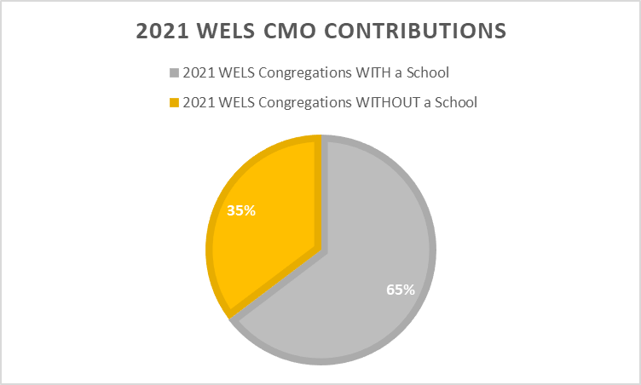
443
230,426
779
107,312
⅓ of the Congregations have schools and
have ⅔ of the members and contribute ⅔ of the CMO
$15 million
$8.2 million

Slide 23
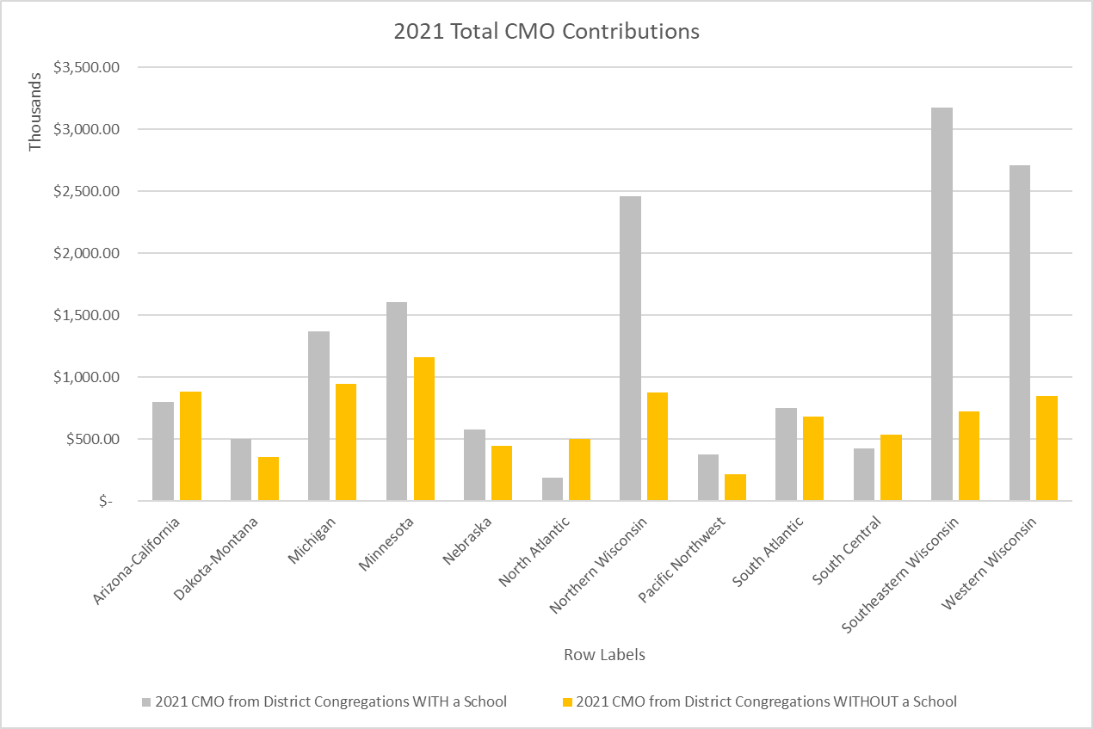
72
71
67
54
46
91
76
90
88
91
36
27
49
65
10
29
37
41
61
62
15
10
6
28

Slide 24
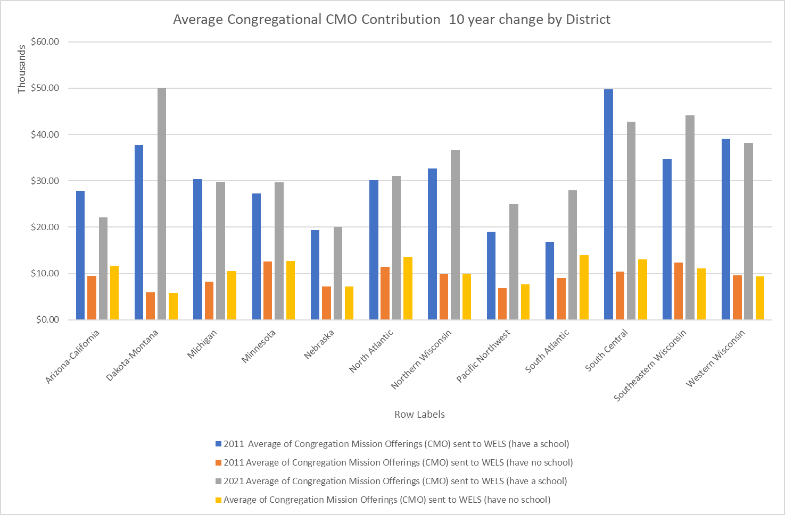
1:2
1:0.6
1:2
1:6
1:2
1:2
1:4
1:2
1:6
1:0.8
1:0.8
1:0.9

Slide 25
Change from 2012 to 2022
22% CMO Increase for Congregations with Schools
17% CMO Increase for Congregations without a school
30.17% inflation rate

Slide 26
Barriers to Overcome
Feelings of Failure
Institutional Inertia
Notes:
Undiscussable - Feelings of Failure - generations schools have been funded through primarily offerings; generation to let the school die
Institutional Inertia -easiest to not do anything; wait and see has led many schools finances into the gutter; change to how we fund our schools is vital; Organic structure with flexibility will be needed to empower this change.
Paradigm Shift -Let go of notion there is one way to fund our schools; tuition and 3rd source undermine stewardship and first fruits giving; not everyone needs low cost tuition; providing assistance to the families that truly need it will actually free up money for other purposes. 85% of Students in College get some kind of financial aid. That equates to 4227 students receiving aid that could afford to pay what it costs to educate a student
Pursuing excellence- deviating from the norm is the path to excellence, but normalizing the path to excellence could be difficult to replicate

Slide 27
“People seek solutions to new problem in the same place where they found the old ones. . . Instead of responding creatively, people increase their commitment to their old patterns. They implement the most ingrained natural response.”
Robert E. Quinn, Deep Change (1996) p.54
Notes:
FInancial Model where much of the funding comes from church offerings and low priced tuition
Not kept pace with:
Expectations of parents
Costs of doing business
Demands for richer programming
Deep change is needed to stave off a slow death.

Slide 28
Barriers to Overcome
Feelings of Failure
Institutional Inertia
Paradigm Shift
Pursuing excellence is difficult (and expensive)
Notes:
Undiscussable - Feelings of Failure - generations schools have been funded through primarily offerings; generation to let the school die
Institutional Inertia -easiest to not do anything; wait and see has led many schools finances into the gutter; change to how we fund our schools is vital; Organic structure with flexibility will bee need to empower this change.
Paradigm Shift -Let go of notion there is one way to fund our schools; tuition and 3rd source undermine stewardship and first fruits giving; not everyone needs low cost tuition; providing assistance to the families that truly need it will actually free up money for other purposes. 85% of Students in College get some kind of financial aid. That equates to 4227 students receiving aid that could afford to pay what it costs to educate a student
Pursuing excellence- deviating from the norm is the path to excellence, but normalizing the path to excellence could be difficult to replicate

Slide 29
“When the rate of change inside an institution becomes slower than the rate of change outside, the end is in sight. The only questions is when.”
Former General Electric CEO Jack Welch
Notes:
FInancial Model where much of the funding comes from church offerings and low priced tuition
Not kept pace with:
Expectations of parents
Costs of doing business
Demands for richer programming
Deep change is needed to stave off a slow death.

Slide 30
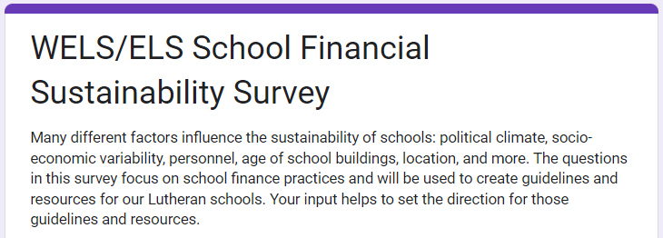
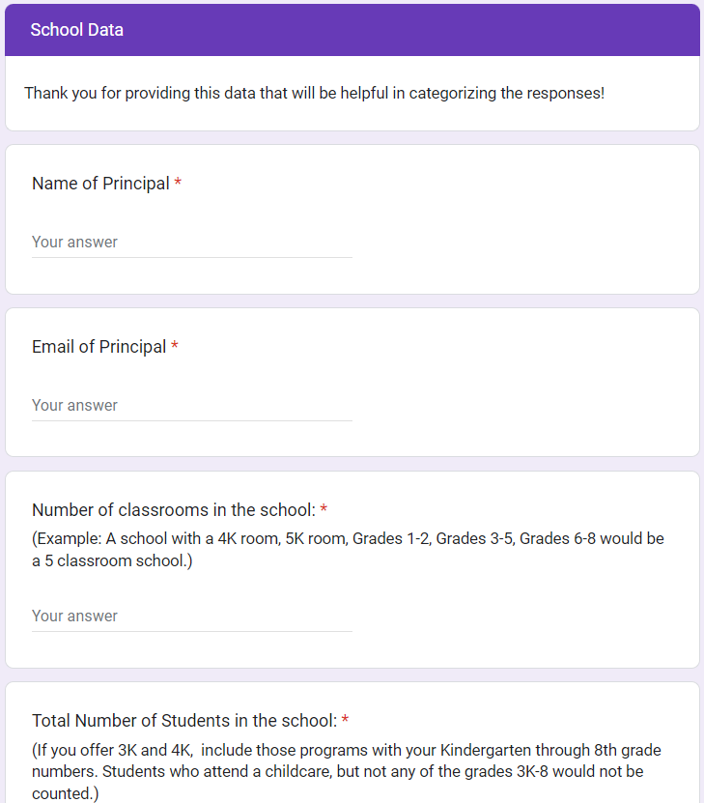
305 207 85 75
WELS/ELS Schools contacted
Opened Survey
Clicked within the survey
Completed the survey
 | Average # of Students | Average COE | Average Tuition
2022 All WELS Schools | 118 | $7,285.91 | $2,604.52
2022 Sustainability Survey | 152 | $7,429.74 | $2,641.15

Slide 31
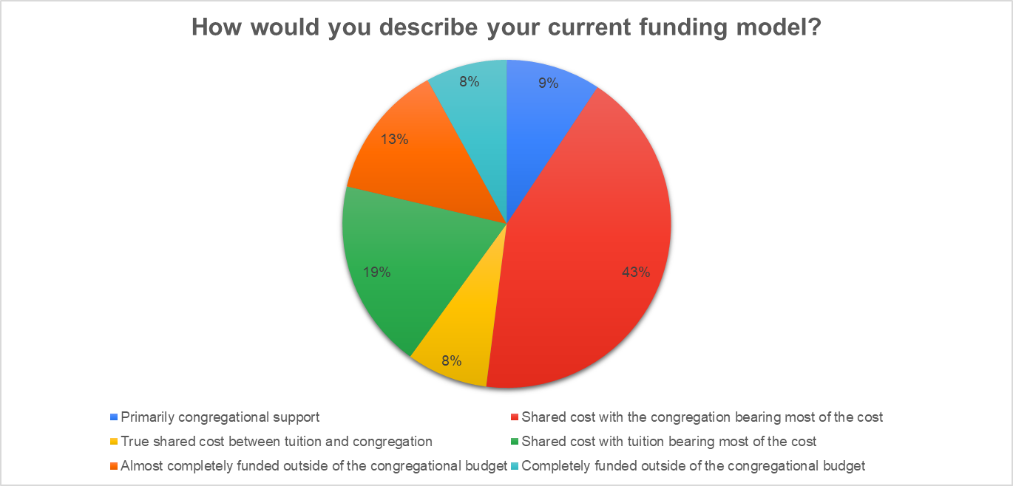

Slide 32
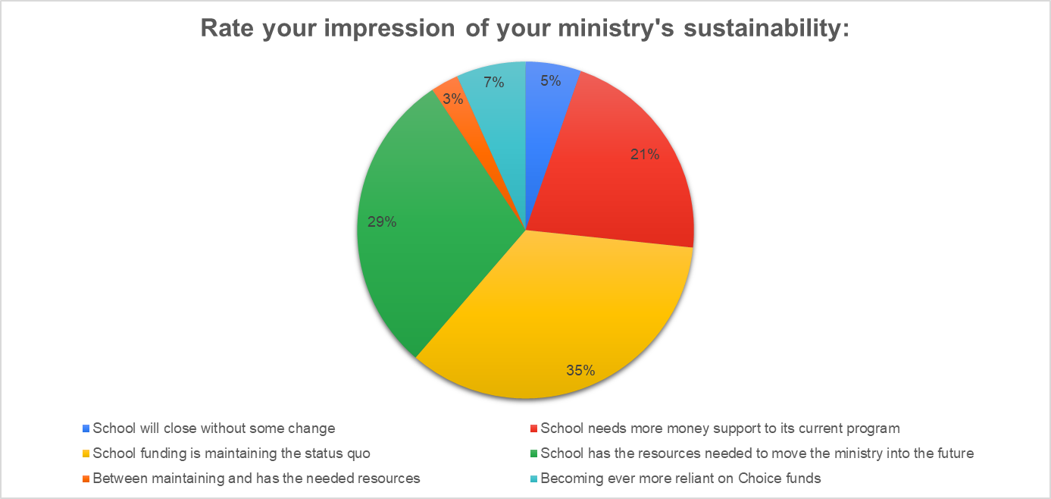

Slide 33
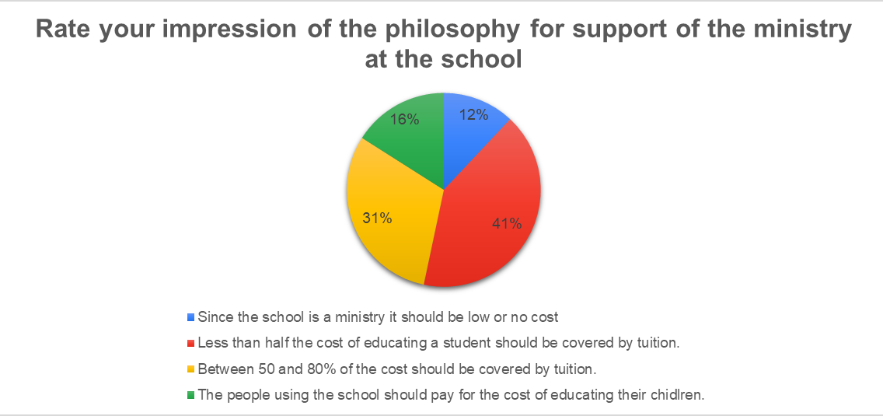

Slide 34
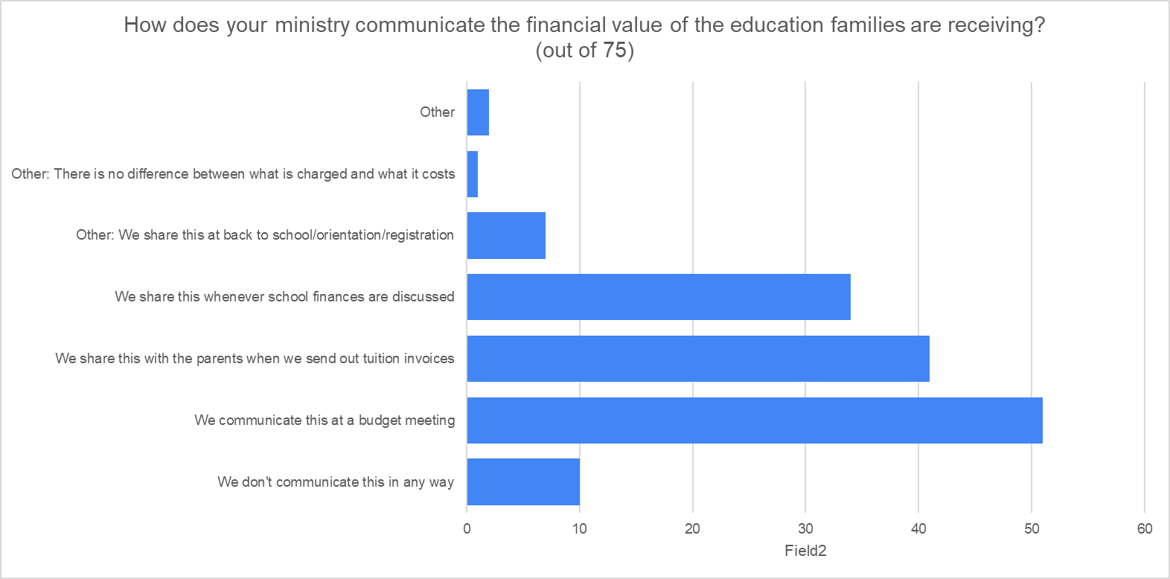
Number of People

Slide 36
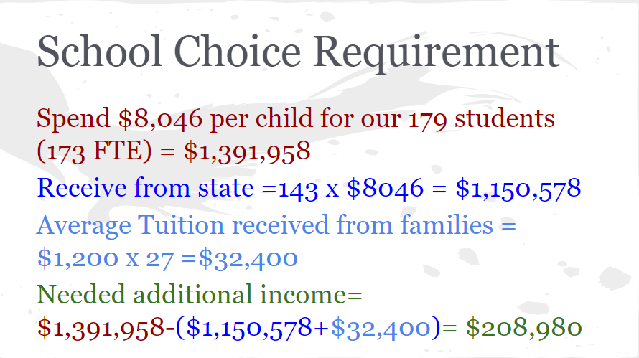

Slide 38
Open Minds Closed Funding Gap
Current
Transition
Many schools are underfunding their programs because of low tuition and high demands on church contributions
Schools adopt policies like guiding how tuition is set, identifying cost of education per child, and incorporating community demographics
LEWIN
ADKAR
Notes:
Share Current state and future state

Slide 39
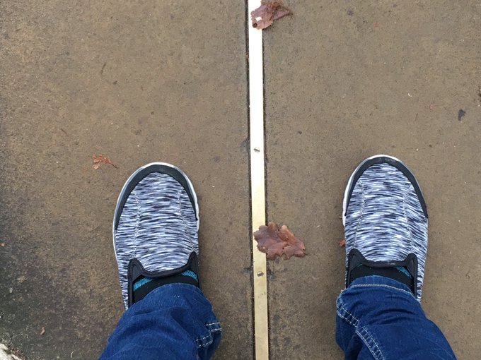
A school has one foot in the church and one foot in the world.
God’s Word provides the direction
Offerings fund our ministry
We are ministering to souls
Focus on Christ
Nurture the church’s children
Answerable to stakeholders
Schools are transactional
We must maintain a learning climate
Focus on Reading and Math
Serve the community we are in
Church
World

Slide 40
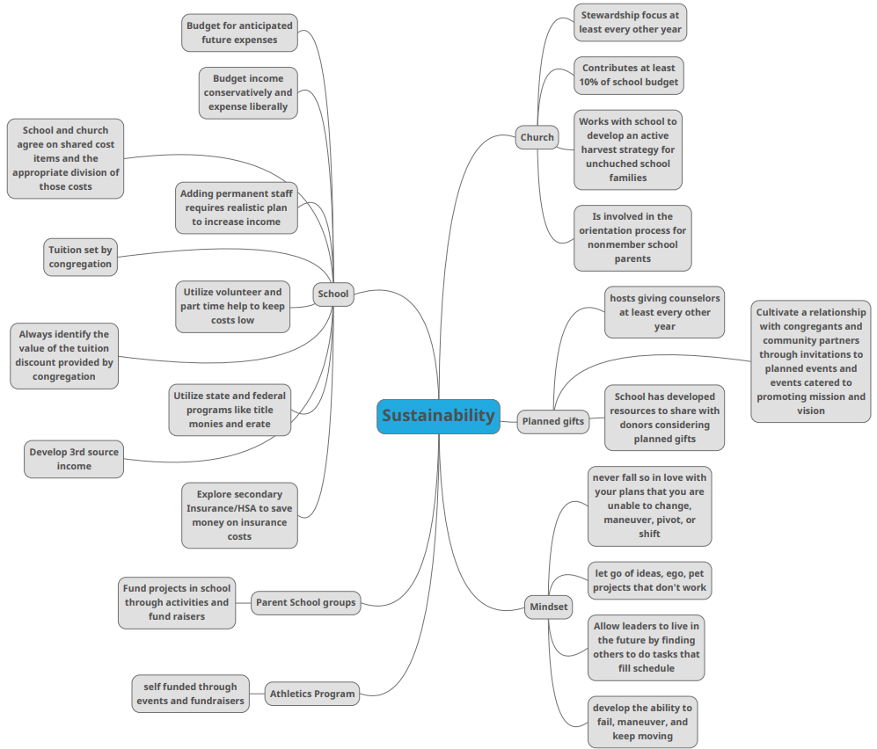
Notes:
Fourth edition of a Sustainability Map.
I tried to identify a best practice in each area as an initial way schools can evaluate their financial health.
For example: School - Tuition set by congregation
Planned Gifts - Engage Stakeholders
Mindsdet - allow leaders time to live in the future

Slide 41
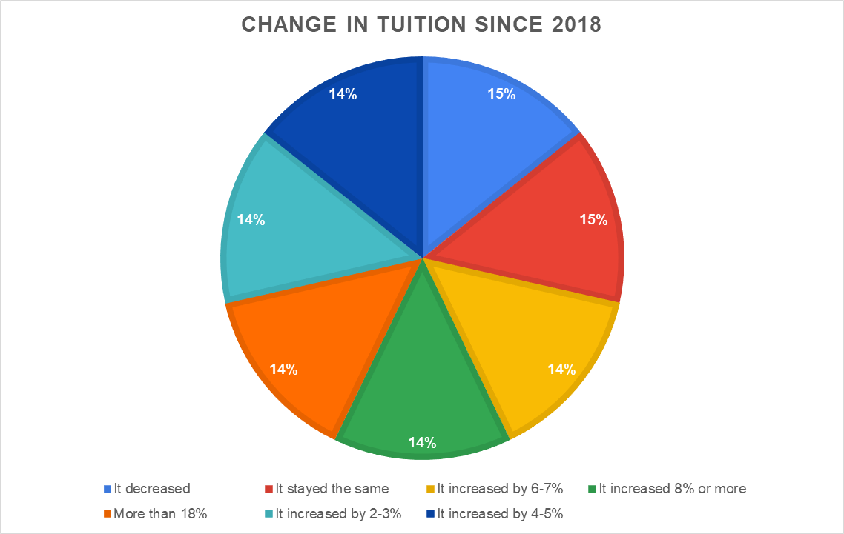

Slide 42
The US dollar has lost more than 15% of is value since 2018.
Average inflation rate has ben 3.4% over 5 years or 18.14%

Slide 43
Rethinking - Tuition Philosophy
Courtesy of Seth Fitzsimmons St Paul Muskego

Slide 44
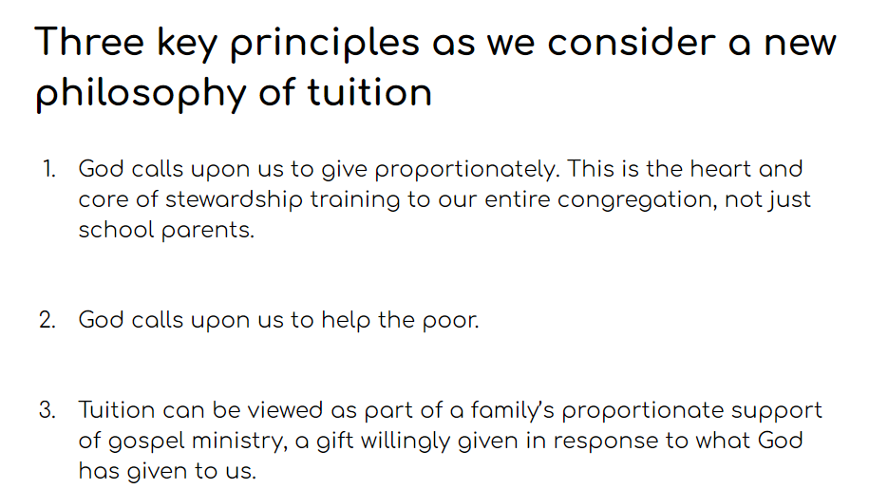
Four Biblical Pillars to a Tuition Philosophy
Each according to their need
Providing service regardless of income
Preventing the poorer from subsiding the richer
Joyful Giving
Grace Works Ministries: Towards a Lutheran Theology of Tuition and Financial Aid for Christian Schools
Courtesy of Seth Fitzsimmons St Paul Muskego
Notes:
These discounts irrespective of what these families can afford to pay. But in fact someone must pay what it actually costs to educate these precious children.

Slide 45
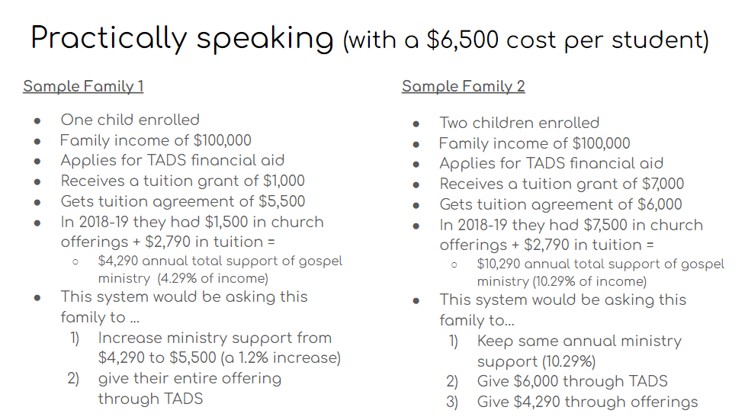
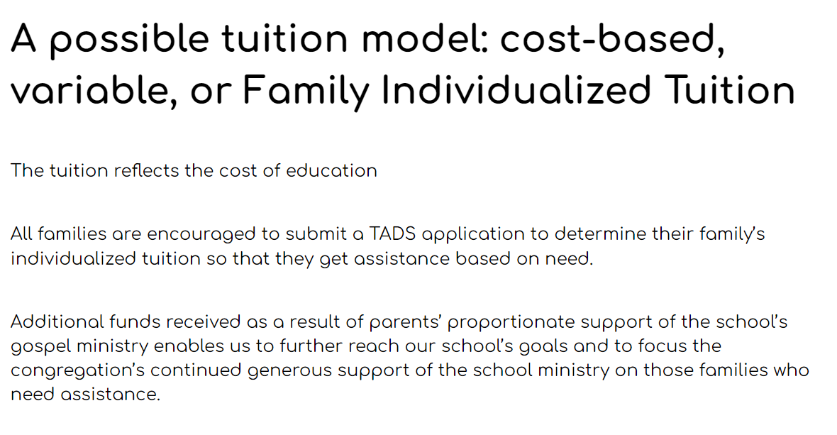
Rethinking - Tuition Philosophy
Courtesy of Seth Fitzsimmons St Paul Muskego

Slide 46
Rethinking - Setting Tuition
Traditional Budgeting
New Normal
Identifying needs and expenses
Set Tuition
Tuition INCREASES necessary to expand program and staff and sustain small class sizes and competitive salaries
Determine tolerance for Tuition Increase:
Economic Assessment of the community’s capacity to pay
Demographic study projecting how many families have that capacity to pay
Assessment of the school’s enrollment strength in the marketplace.
Set Price and determine income
Evaluate expenses to determine the possibility of non-tuition revenue increases or cost decreases
NAIS Game Changing Model

Slide 47
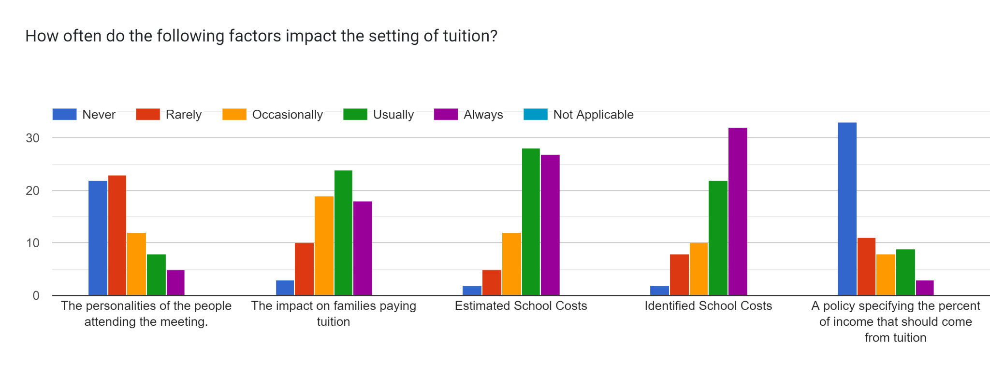
Needed Policies/Practices/Procedures:
Cost of Education
(Non Voucher Areas) What percentage of income should come from tuition?
Market and Demographic Study (MissionInsite)
Notes:
61% of school have a formal process to identify school costs in the budget.

Slide 48
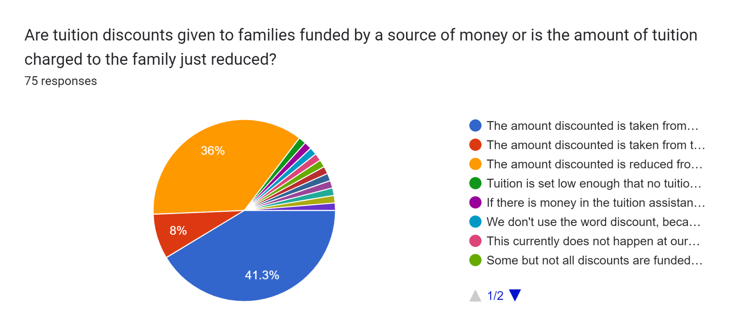
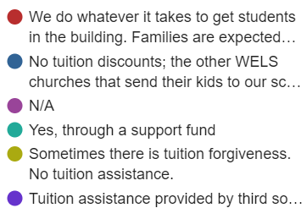

Slide 49
Indexed Tuition
85% of Families receive some sort of financial aid (FAFSA)
Average WELS LES Cost of Education - $7,285
Average Non-Member Tuition for WELS LES - $4,159 ($3,126 subsidized!)
Average Member Tuition for WELS LES - $2,604 ($4,681 subsidized!)
Indexed Tuition Basics
Notes:
21.6 million (7200*3000 Other
13.8 million (4600*3000) no
3.24 million (21.6 mil *15%) Other
2.07 million (13.8 * 15% No
75.4 million (16400*4600) WELS
$11.3 million (75.4 mil *15%) WELS

Slide 50
Indexed Tuition
Barriers
Mission
Mostly Vouchers
Debt Ratio
Competitive Market
Not Needed/ Finances are stable
Not Fair
Funding Financial Aid
Administration
Privacy
Unfamiliar Change
Inertia/History
Duty

Slide 51
“The sustainability conversation often omits the single most important question any school must ask: what makes our school’s educational experience relevant, valuable, and transformative for students?”
Greenwich Leadership Partners
Notes:
FInancial Model where much of the funding comes from church offerings and low priced tuition
Not kept pace with:
Expectations of parents
Costs of doing business
Demands for richer programming
Deep change is needed to stave off a slow death.

Slide 52
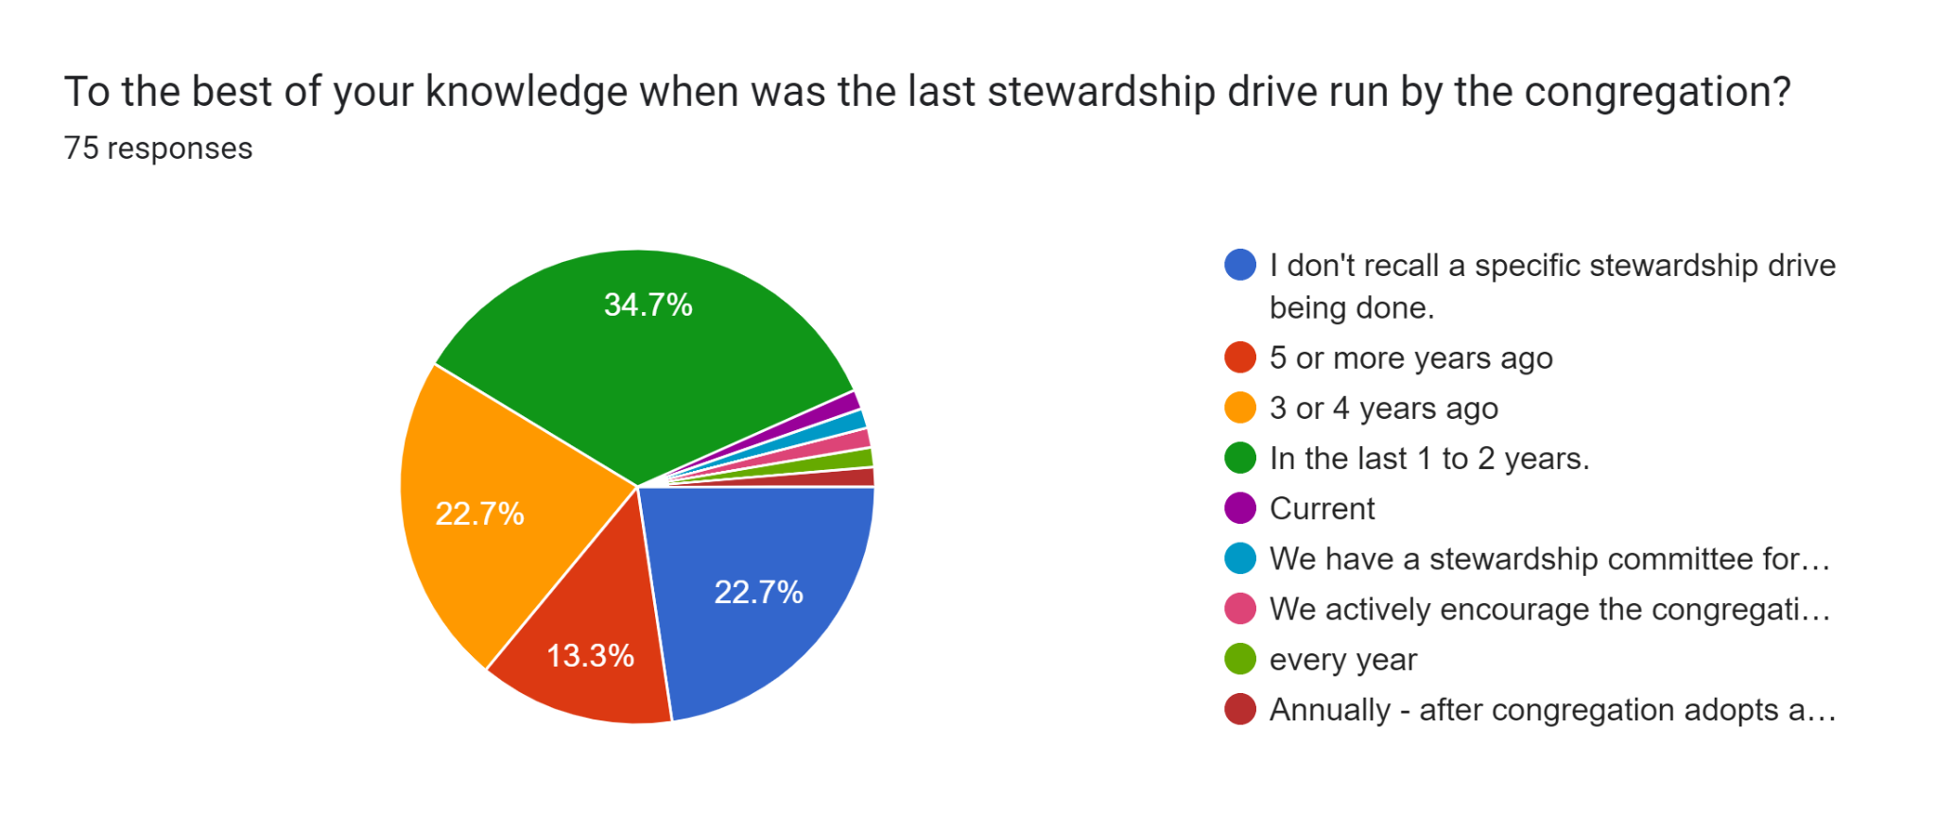
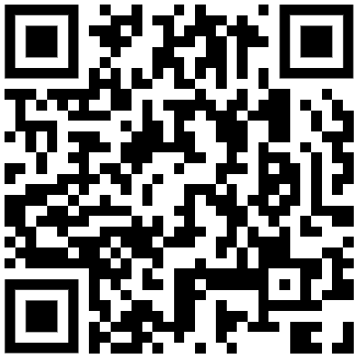
Ministry Balance

Slide 53
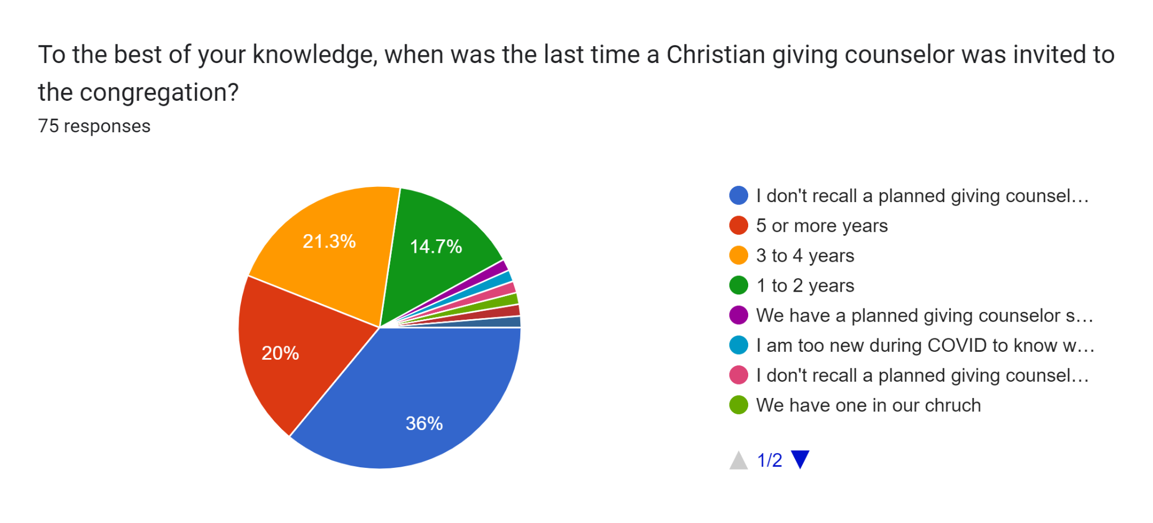
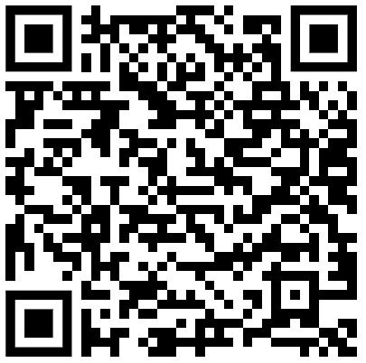
Ministry Balance

Slide 54
Muskego screen shots
Courtesy of Seth Fitzsimmons St Paul Muskego

Slide 55
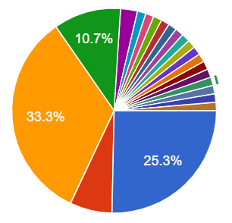
Surfers on the Sustainability Cutting Edge:
Build a fund to cover all summer expenses
Build a rainy day/contingency fund
Fund your financial aid awards
Fund your depreciation
No Budget; Special gifts needed
Unspent Money from Budget saved
Small amount set aside not based on actual costs
Depreciation plan made; strive to fund
Depreciation plan made; fully funded (2.7%)
6.7%

Slide 56
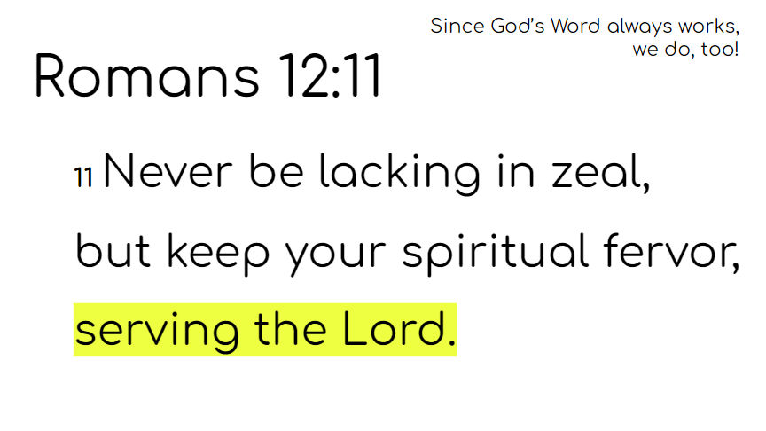
Final Thoughts:
What will you pay your staff? (70% of budget goes to wages and benefits)
What type of accreditation will you pursue?
What type of facility will that accreditation require?
What is your retention level?
What other revenue streams exist?
Scan the Horizon - What market reality might hit our school in 3,5,10, 20 years?
Excellence - pursuit in all things
Sustainability: Dr Larry Taylor Prestonwood Christian Academy

Slide 57
Open Minds Closed Funding Gap
Current
Transition
Future
Many schools are underfunding their programs because of low tuition and high demands on church contributions
Schools adopt policies like guiding how tuition is set, identifying cost of education per child, and incorporating community demographics
Schools are sustainably funded through improved funding practices appropriately divided among the stakeholders
LEWIN
ADKAR
Notes:
Share Current state and future state

Slide 58
Incorporating Change Management Strategies
Tie change to the purpose of the organization
Provide training and support through the change process
Present strong rationale so independent minded organizations will buy into the change
Offer strong models for the formalization of the change
Notes:
Characteristics:
•Strong sense of purpose
•Focus on individual development
•Trust and openness
•Employee empowerment
•Toleration of employee expression

Slide 59
SUMMARY
Financial Sustainability is a challenge that most are hoping will go away
Institutional Inertia can be overcome with
Awareness
Success Stories
Consulting
Re-examine your financial practices and philosophy in order to increase the likelihood of sustainability

Slide 60
Congregational Change Efforts
Smooth Sailing Women and Children First
How can your congregation facilitate smooth sailing?

Slide 62
OPENING MINDS TO CLOSING THE FUNDING GAP
Addressing the Financial Sustainability of WELS Schools
paul.patterson@wels.net
January 2023
Notes:
Congregational Services Division
Addressing Needs of Churches and Schools
Highest pain points

Slide 63
Abstract
This project, begun in the Business Certificate for School Leaders Certificate program, investigated the presence of sound financial practices in Wisconsin Evangelical Lutheran Synod (WELS) schools. Over half of WELS schools charge less than the cost to operate. Funding is identified as a major challenge to competitive salaries, innovative programming, and future school development. After researching financially sustainable practices, a survey was developed to inform the creation of a self evaluation tool for schools. This tool will help point schools to different resources to assist them in improving their sustainability. Since funding practices are culturally ingrained, change management strategies will need to be incorporated by schools who tackle sustainability challenges.
Keywords: Tuition Model, financial sustainability, funding, school closings, gap, change management

Slide 64
OBJECTIVES OF OPEN MINDS CLOSED GAPS
Expose all WELS schools to the Financial Sustainability Evaluation Tool – January and October 2023
50% of WELS Schools use the Evaluation tool in first two years
Expose all WELS schools to resources that promote sustainability – January and October 2023
Consult with 5 schools each year regarding sustainability
Notes:
Note what happens in January and October

Slide 65
A school has one foot in the church and one foot in the world.
Aligning more effectively with today’s realities can only occur if we are willing to journey into the unknown territory and confront the wicked problems we encounter. pg 9
Each of us has the potential to change the world. Because the price of change is so high, we seldom take on the challenge. p11
People seek solutions to new problem in the same place where they found the old ones. . . Instead of responding creatively, people increase their commitment to their old patterns. They implement the most ingrained natural response.p.54
It is much easier and safer for us to stay with in the zone of certainty, particularly wehn we are mired in the slow death dilemma. We must reach a point of ultimate despair and frustration before we seriously thing about initiating deep change. p.86
Malachi 3:10
“Bring the full tithe into the storehouse, that there may be food in my house. And thereby put me to the test, says the Lord of hosts, if I will not open the windows of heaven for you and pour down for you a blessing until there is no more need.”

