Slide 1

Digging Deeper: Getting More out of Your Time in the Word

Slide 2
Why?
Call to me and I will answer you and tell you Great and unsearchable things you do not know.
Jeremiah 33:3

Slide 3
How?
“In the past god spoke to our ancestors through the prophets at many times and in various ways, but in these last days he has spoken to us by his son, whom he appointed heir of all things…” Hebrews 1:1-2

Slide 4

Future
Relationships
Hardships
health
Money
death

Slide 5
Future:
Horoscopes
Trends
Projections
Ask: How long?

Slide 6
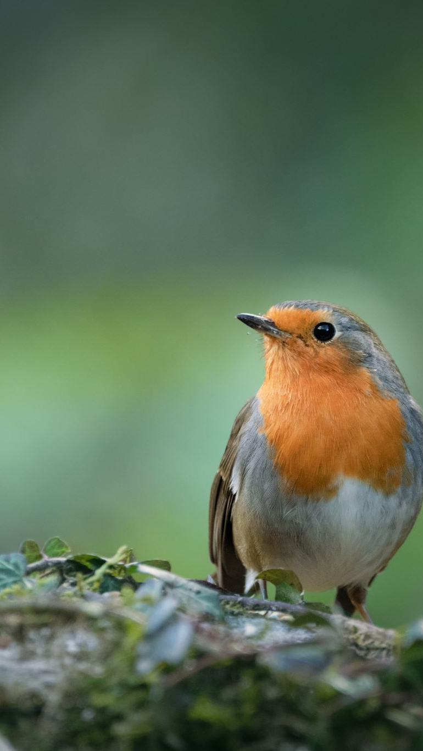
Matthew 6:25-27, 34
Therefore, I tell you, do not worry about your life, what you will eat or drink; or about your body, what you will wear. Is not life more than food, and the body more than clothes? Look at the birds of the air; they do not sow or reap or store away in barns, and yet your heavenly Father feeds them. Are you not much more valuable than they? Can any one of you by worrying add a single hour to your life? … But seek first his kingdom and his righteousness, and all these things will be given to you as well.

Slide 7
Relationships:
Arguments
Tension
Unmet expectations
severed

Slide 8

“Do nothing out of selfish ambition or vain conceit, but in humility consider others better than yourselves.” Philippians 2:3
“Be completely humble and gentle; be patient, bearing with one another in love.” Ephesians 2:4

Slide 9
Hardships:
Car breaks down
New roof
Persecution
Not chosen

Slide 10
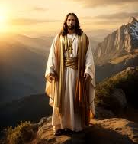
John 16:33
In this world you will have trouble. But take heart! I have overcome the world!

Slide 11
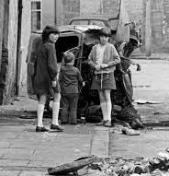
2 Corinthians 4:17
“For our light and momentary troubles are achieving for us an eternal glory that far outweighs them all.”

Slide 12
Health:
Mental/physical
Old age
Disease
diagnosis

Slide 13
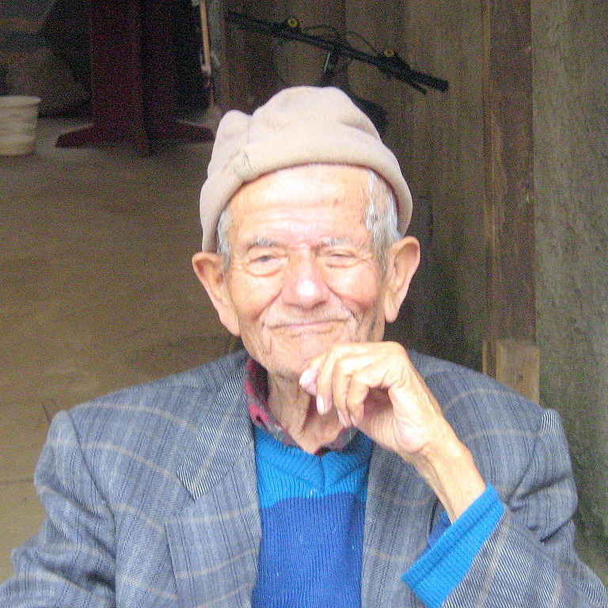
2 Corinthians 4:16
“Therefore, we do not lose heart. Though outwardly we are wasting away, inwardly we are being renewed day by day.”

Slide 14
Money:
How much is enough?
Cost of living
Unexpected loss

Slide 15

“Do not store up for yourselves treasures on earth, where moth and rust consume and where thieves break in and steal; but store up for yourselves treasures in heaven, where neither moth nor rust consumes and where thieves do not break in and steal.” Matthew 6:19-21

Slide 16

“Watch out!
Be on your guard against all kinds of greed; life does not consist in an abundance of possessions.”
Luke 12:15

Slide 17
Death:
Why now?
Why That way?
Why her/him?

Slide 18
“The wages of sin is death, but the gift of god is eternal life.” Romans 6:23

Slide 19
Jesus said, “If I go and prepare a place for you, I will come back and take you to be with me that you also may be where I am.” John 14:3

Slide 20
“The kingdom of heaven is like treasure hidden in a field. When a man found it, he hid it again, and then in his joy went and sold all he had and bought that field.” Matthew 13:44

Slide 21
“Do nothing out of selfish ambition or vain conceit, but in humility consider others better than yourselves.” Philippians 2:3

Slide 22
selfish ambition/vain conceit:
Selfish: a person, action or motive lacking consideration for others, concerned chiefly with one’s own personal profit or pleasure.
Ambition: a strong desire to do or achieve something.
Vain: showing an excessively high opinion of one’s appearance, ability or worth.
Conceit: excessive pride in oneself.

Slide 23
IMPORTANT NOTE!:
Not every word in the Bible is meant to be read with its literal definition!
Psalms/Revelation: horn
A hard permanent outgrowth found on the head of cattle.
A horn is a symbol of power

Slide 24

Selfish: How often do I think only of myself?
Ambition: What am I trying to achieve?
Vain: in what areas do I think I’m better than others?
Conceit: how often do I steal glory that belongs to God?

Slide 25
selfish ambition/vain conceit:
Selfish: How often do I think only about myself?
Ambition: What am I trying to achieve?
Vain: In what areas do I think I’m better than others?
Conceit: How often do I steal glory that belongs to God?

Slide 26
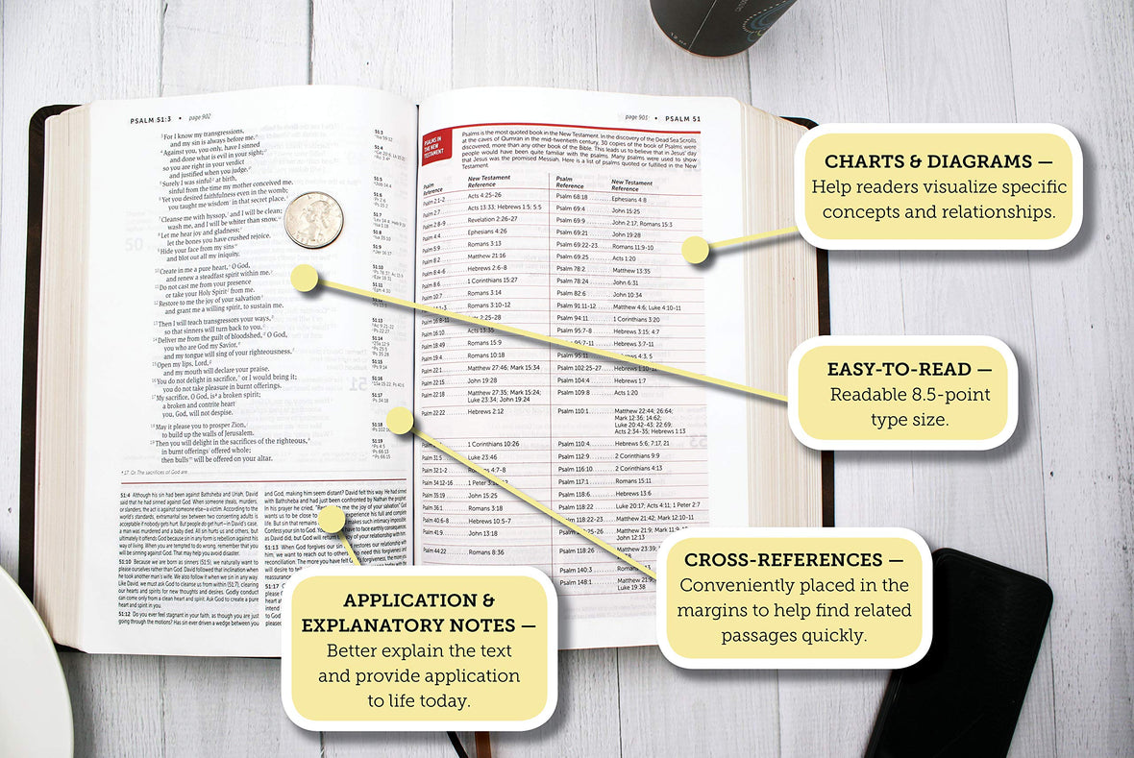

Slide 27
selfish ambition/vain conceit:
Study Bible: “[Selfish ambition and vain conceit] The mortal enemies of unity and harmony in the church…
Concordia Self-Study Bible NIV 1984

Slide 28
Selfish: How often do I think only of myself?
Ambition: What am I trying to achieve?
Vain: in what areas do I think I’m better than others?
Conceit: how often do I steal glory that belongs to God?
These contribute to the destruction of the church, family, work environment…
How has my selfishness effected my church? How
has what I’m trying to achieve kept me from the Lord’s work? Do I think I’m too good to do
something?

Slide 29
selfish ambition/vain conceit:
Study Bible: “[Selfish ambition and vain conceit] The mortal enemies of unity and harmony in the church (cf 1:17; see Gal 5:20, where selfish ambition is listed among the “acts of the sinful nature”.)
Concordia Self-Study Bible NIV 1984

Slide 30
Cf is an abbreviation for the Latin word confer, meaning “compare.”

Slide 31
selfish ambition/vain conceit:
Philippians 1:15-17 “It is true that some preach Christ out of envy and rivalry, but others out of goodwill. The latter do so out of love, knowing that I am put here for the defense of the gospel. The former preach Christ out of selfish ambition, not sincerely, supposing that they can stir up trouble for me while I am in chains.”

Slide 32
selfish ambition/vain conceit:
Note on Philippians 1:15-17 “Paul does not accuse his rivals of false teaching, but he does fault them for their motive. Their motive for sharing the gospel with others was not sincere. They saw the acclaim given to Paul and became envious. Their concern was for outward recognition, and so their ambition led them to look on Paul as a rival whom they wanted to outshine.”
EHV Self-study Bible

Slide 33
Selfish: How often do I think only of myself?
Ambition: What am I trying to achieve?
Vain: in what areas do I think I’m better than others?
Conceit: how often do I steal glory that belongs to God?
These contribute to the destruction of the church…
What is my motive for the work I do/don’t do in God’s kingdom?

Slide 34
selfish ambition/vain conceit:
Galations 5:20, “The acts of the flesh are obvious: sexual immorality, impurity and debauchery; idolatry and witchcraft; hatred, discord, jealousy, fits of rage, selfish ambition, dissensions, factions…”

Slide 35
Selfish: How often do I think only of myself?
Ambition: What am I trying to achieve?
Vain: in what areas do I think I’m better than others?
Conceit: how often do I steal glory that belongs to God?
These contribute to the destruction of the church…
What is my motive for the work I do?
These are in contrast to the fruit of the Spirit.

Slide 36
selfish ambition/vain conceit:
Galations 5:22, “The fruit of the Spirit is love, joy, peace, patience, kindness, goodness, faithfulness, gentleness and self-control.”

Slide 37
Selfish: How often do I think only of myself?
Ambition: What am I trying to achieve?
Vain: in what areas do I think I’m better than others?
Conceit: how often do I steal glory that belongs to God?
These contribute to the destruction of the church…
What is my motive for the work I do?
These are in contrast to the fruit of the Spirit.
Love
Joy
Peace
Patience
Kindness
Goodness
Faithfulness
Gentleness
Self-control

Slide 38
Love: Deep affection: all the attributes of God
Joy: Happiness despite circumstances, contentment
Peace: Shalom: complete/whole, nothing missing
Patience: Tolerate delay or suffering without anger
Kindness: being kind, the words you choose, tone you use, actions you take.

Slide 39
Goodness: Being morally good, virtuous.
Faithfulness: Loyal, steadfast, unwavering
Gentleness: Having a mild, kind, tender temperament.
Self-control: the ability to control one’s behavior, emotions, actions.

Slide 40
How do I get the fruit of the Spirit?
Note: Concordia Self-Study Bible:
“Christian character is produced by the Holy Spirit, not by the mere moral discipline of trying to live by law. … The indwelling Holy Spirit produces faith and Christian virtues in the believer’s life.”
How then do I produce this fruit if I’m not seeing evidence of it in my life?
-Pray (God loves when we pray for spiritual things)
-Study the Bible

Slide 41
“Do nothing out of selfish ambition or vain conceit, but in humility consider others better than yourselves.” Philippians 2:3

Slide 42
Humility
Humility: a modest or low view of one’s importance

Slide 43
C.S. Lewis Mere Christianity
“Do not imagine if you meet a really humble man he will be what most people call ‘humble’ nowadays: …Probably all you will think about him is that he seemed a cheerful, intelligent chap who took a real interest in what you said to him. If you do dislike him it will be because you feel a little envious of anyone who seems to enjoy life so easily. He will not be thinking about humility: he will not be thinking about himself at all.”

Slide 44
C.S. Lewis Mere Christianity
“If anyone would like to acquire humility, I can, I think, tell him the first step. The first step is to realize that one is proud. And a biggish step, too. At least, nothing whatever can be done before it. If you think you are not conceited, it means you are very conceited indeed.”

Slide 45
Based on C.S. Lewis’ view of humility/conceit, I need to
work on…

Slide 46
C.S. Lewis Mere Christianity
-Do I have a genuine concern for others?
-Try not to think about yourself at all
-I am proud
-This leads to repentance
-asking God to help you be less proud

Slide 47
“Do nothing out of selfish ambition or vain conceit, but in humility consider others better than yourselves.” Philippians 2:3

Slide 48
The People’s Bible (pg. 39)
“…it is always characteristic of human nature to minimize one’s own weaknesses and to exaggerate one’s own strengths, while doing just the opposite when observing the weaknesses and strengths of others. These … can severely [diminish] the spiritual growth of any congregation. “

Slide 49
Based on C.S. Lewis’ view of humility/conceit, I need to
work on…
It is human nature to minimize my weaknesses
and exaggerate my strength.
Strengths
Weaknesses

Slide 50
The People’s Bible (pg. 39)
Paul encourages the Philippians to strive for greater unity of disposition, lowliness and helpfulness. Unity of disposition is the common view of life that believers ought to share, because they have been united by the Spirit in a common faith in the Lord Jesus.

Slide 51
The People’s Bible (pg. 40)
First century society placed little value on lowliness. It regarded it, in fact, as the equivalent of cowardice and equated pride and self-assertiveness with manhood. …Looking out for number one is still tremendously popular. The world=me first, and everyone else after me, if at all.

Slide 52
The People’s Bible (pg. 40-41)
Paul does not want talented believers to deny their special gifts or hide or neglect them. …A humble child of God, …will strive to put the best construction on everything the neighbor does.
Can the same be said of us? Or does our self-assertiveness show our lives are not as Spirit-directed as they should be?

Slide 53
Based on C.S. Lewis’ view of humility/conceit, I need to
work on…
It is human nature to minimize my weaknesses
and exaggerate my strength.
Strengths
Weaknesses
Am I quick to defend myself, but put others down?

Slide 54
The People’s Bible (pg. 39)
[Humble Christians] love one another with the unselfish kind of love that gives without expecting anything in return and finds its motive and example in the love of Christ. And …Christians agree on the great common goal of promoting Jesus’ kingdom in the world.

Slide 55
Based on C.S. Lewis’ view of humility/conceit, I need to
work on…
It is human nature to minimize my weaknesses
and exaggerate my strength.
Strengths
Weaknesses
How is my behavior promoting Jesus in the church,
in the community, workplace, neighborhood, etc.

Slide 56
Cross-references
A cross-reference in the Bible is a link between verses that share a similar theme or topic. Cross-references can also connect people, phrases, or locations. They are often found in the margines or footnotes of the Bible.
63,779 cross-references in the Bible

Slide 57
Cross-references for Philippians 2:3
Romans 12:10
Galatians 5:26
Ephesians 4:2
Ephesians 5:21
1 Peter 5:5
James 3:14-16
James 4:5-6
Philippians 2:14
1 Timothy 6:4
Luke 18:14
Galatians 5:15
Luke 14:7-11
Proverbs 13:10
1 Peter 2:1-2
2 Corinthians 12:20
Colossians 3:8
Philippians 1:15-16
1 Corinthians 3:3
1 Corinthians 15:9
Galatians 5:20-21
Romans 13:13

Slide 58


Slide 59

How does this lead me to pray?
Humility/Pride
How can I be most affective in the kingdom of God?
Forgive me!
Thank you, God for loving me, saving me, being my guide, never giving up on me.

Slide 60
Tools for digging deeper in the Word
Study Bible: NIV/EHV
The People’s Bible Series
https://www.wisluthsem.org/resources/essay-files/
GotQuestions.org
Josephus/Ylvisaker/Spurgeon/Walther

Slide 61
Thank you
amber@timeofgrace.org
Amberalbeeswenson.org

