Slide 1

COME AND STAY
Notes:
Come and Stay
The Story of Lydia and the Story of Us
Good morning!
I ached for this space as a young woman.
A place where woman could consider the kingdom of God
Where women could consider ministry
and be reassured that they have a valuable place in it - as God created them to be
So that being said, I wanted to take a moment for thanksgiving for this, what we are experiencing right now.
Thank you, Women’s Ministry Team, for this space and conversation.
You may not feel it in the daily grind (or minute taking), but you are fostering a genuine environment for women in the WELS and especially for those who are contemplating their place in the Kingdom.
We need this space. I needed this space! May God bless this space. Thank you.

Slide 2

Empowered to Proclaim
Notes:
This conference has the theme “Empowered to Proclaim.”
I wonder how many of you feel empowered to do just that?
What are you seeking here?
Are you feeling confident? Or frustrated?
Do you feel like you belong? Or on the outside looking in?
Do you feel equipped? Is your spirit questioning or bold?
Do you feel like this conference is for you? Or for the ministry of others?
I ask, because I have felt all the above.
Welcome! You are in the perfect spot.

Slide 3
image
mess
the LAMB
free
disciples
priests
HOLY SPIRIT
good
headship
empowered to proclaim
Notes:
And I deeply desire to speak Truth to you all today right from the get-go.
When we get caught up in all of the questions and feelings, we lose sight of who God is and who He is transforming us to be.
So today, let’s start with Truth. Not Elise’s Truth but God’s Truth.
Feel free to shout out your answer to my following questions.
Were women made in the perfect image of God?
But now, do women mess up daily?
Are women bought and redeemed by the blood of the Lamb?
Are women free in Christ?
Are women asked to go and to make disciples of all nations?
Are women part of the royal priesthood, called to share the Gospel?
Do women have the Holy Spirit?
Do women have special gifts from the Holy Spirit for the good of the church?
Can women be active parts of the ministry of the Word AND honor headship?
Are women empowered to proclaim?
Sisters, are we afraid to proclaim?

Slide 4
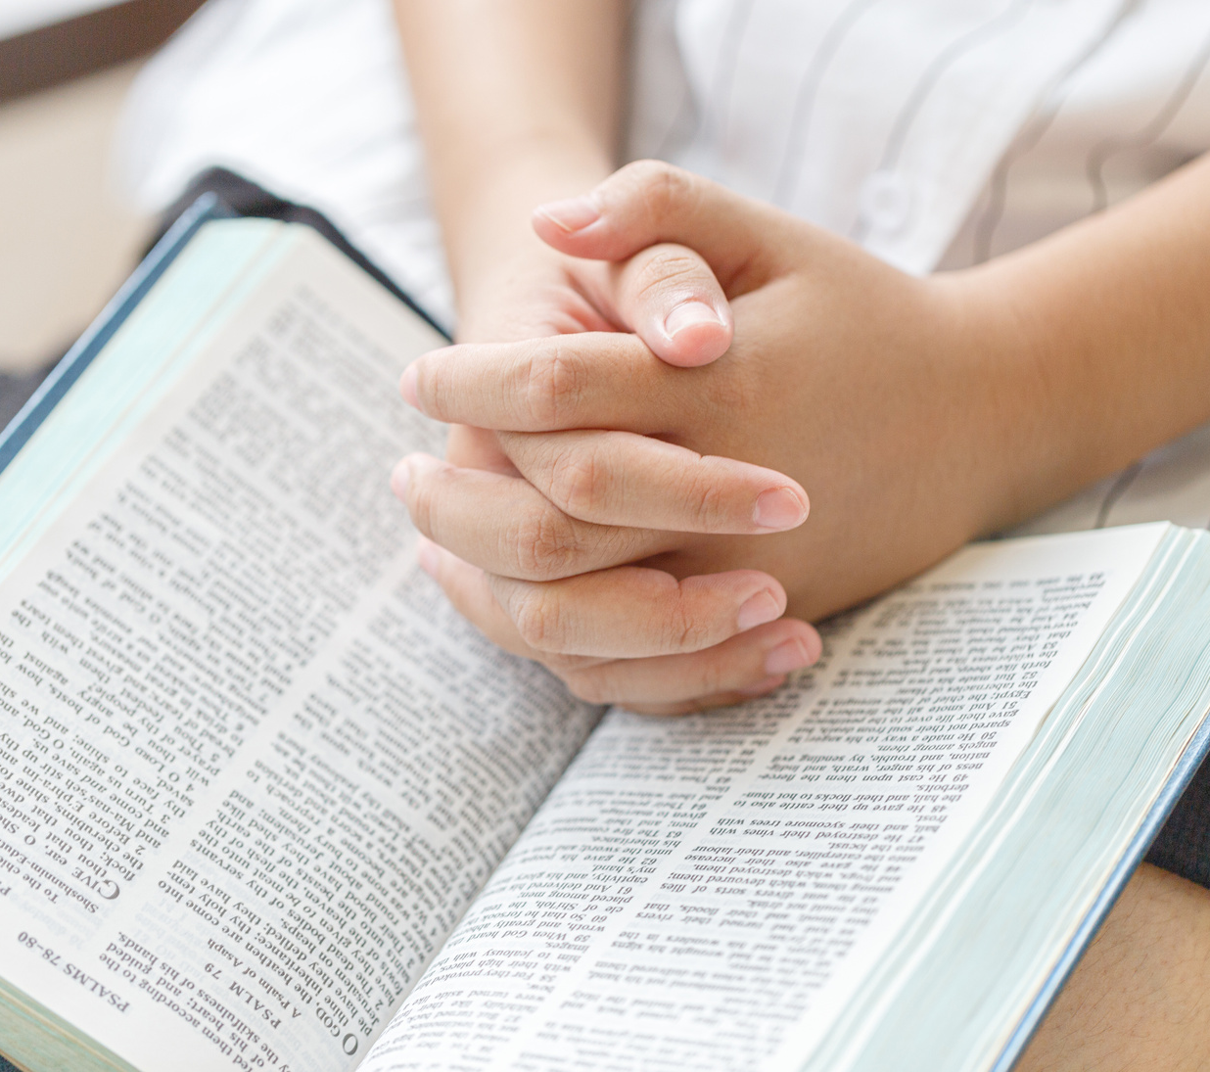





Our goals...
Sit in Scripture
Be Changed by Scripture
Move because of Scripture
Notes:
Here are the goals that I feel led to share with you today. They are simple. God works in the simple.
This is where we are going.
1. Sit in Scripture
How can I speak without sharing Words that actually are life-giving?
The goal is not to hear Elise speak, but to hear God speak. So let’s let Him speak.
2. Be Changed by Scripture
This is the fun part. God’s kingdom is not a “pull yourself up by the bootstraps” kingdom. It is not up to you to rally the strength to believe or to serve.
Your place and growth in ministry and in boldness has nothing to do with you and a whole ton to do with the Holy Spirit.
Feels counterintuitive, but this is faith. This is peace.
3. Move because of Scripture
The reality of Scripture is that the God uses it to work in us the WILL and the ACTION
“For it is God who works in you to will and to act in order to fulfill his good purpose.” Philippians 2:13
Walking with the Spirit means being in the Word. If you want to move… you must sit first. This is the kind of exercise I like! (:

Slide 5
But you are a chosen people,
a royal priesthood, a holy nation,
God’s special possession,
that you may declare the praise of him who called you out of darkness
into his wonderful light.
1 Peter 2:9
Notes:
Friends, YOU are a chosen people, YOU are a royal priesthood, YOU are a holy nation, YOU are God’s special possession,
Why?
So that YOU may declare the praise of him who called you out of darkness into his wonderful light.
My prayer is that you walk away from this session BOLD. Not bold in your own abilities but BOLD in the Lord. Instead of saying “Can I?” or “Am I allowed?” that you walk away saying “How can I not?”

Slide 6

Let’s pray about it
EFESIANS 3:14-21
Notes:
Let’s pray about it
I am going to steal a prayer from Paul. It is the one that he prayed for the church in Ephesians 3:14-21. I love this prayer because it models a correct focus – on the heart, and on absolute trust in God to build His church as He wills.
Ephesians 3:14-21
For this reason, I kneel before the Father, from whom every family in heaven and on earth derives its name. I pray that out of his glorious riches he may strengthen you with power through his Spirit in your inner being, so that Christ may dwell in your hearts through faith. And I pray that you, being rooted and established in love, may have power, together with all the Lord’s holy people, to grasp how wide and long and high and deep is the love of Christ, and to know this love that surpasses knowledge—that you may be filled to the measure of all the fullness of God.
Now to him who is able to do immeasurably more than all we ask or imagine, according to his power that is at work within us, to him be glory in the church and in Christ Jesus throughout all generations, for ever and ever! Amen.
10 MIN

Slide 7
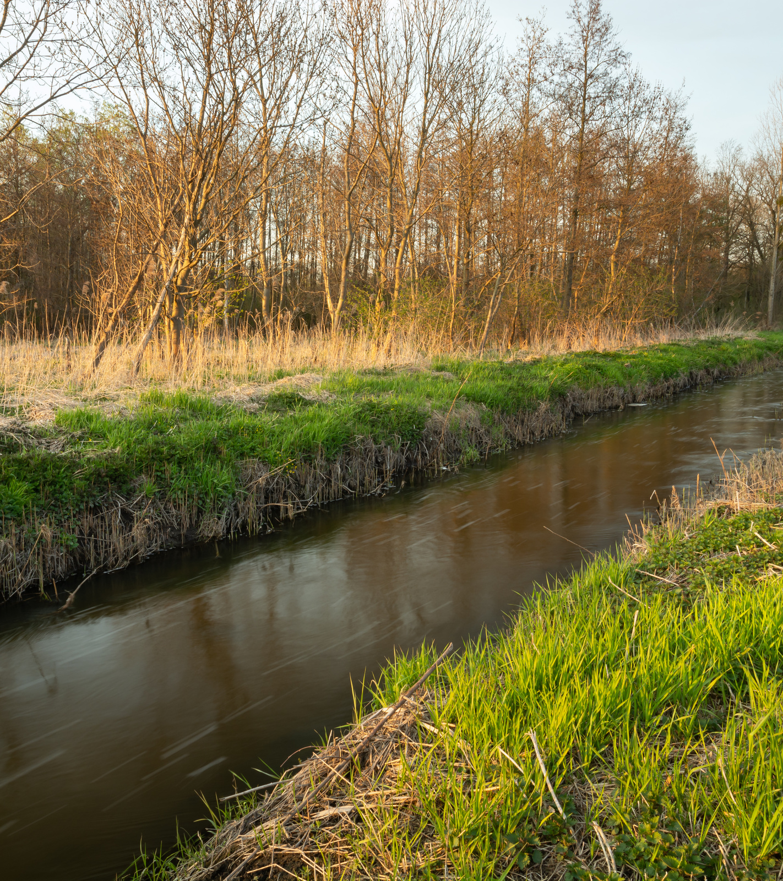
Sit in Scripture
Notes:
Goal #1 – Sit in Scripture
I was asked by the conference committee to present on Acts 16 to the end… ummmmm… did you know there are 28 chapters in Acts?! How much time do we have?
Acts is a pretty insane book. I love to think of Luke observing all the things of the early NT church and trying to squeeze them into 28 chapters – in chapters 16-28 alone we have
the continued missionary journeys of Paul, Silas, Timothy and Luke;
we have the epic accounts of earthquakes, demons, prisons, agitated crowds, great sermons, tent-making, miracles, riots, tears of church leaders bidding Paul goodbye, murder plots, shipwrecks, arrests and trials in Jerusalem and Rome, chains.
Acts is the story of the church… and how God builds His church.
Ironically, when preparing for this conference, instead of being led to the “big” I was led to a tiny part of Acts 16 – the story of Lydia and the church in Philippi.
It’s ironic because I used to roll my eyes at the stories of the women in the Bible – they were not cool enough for me, not big enough.
But man, now I realize how stories like that of Lydia are the simplest expression of what the church actually is and what the gospel message actually does.
The story of Lydia is powerful and it is a story it hold in our back pocket to take out whenever we question our role in ministry and much more importantly, God’s role in building His church.

Slide 8
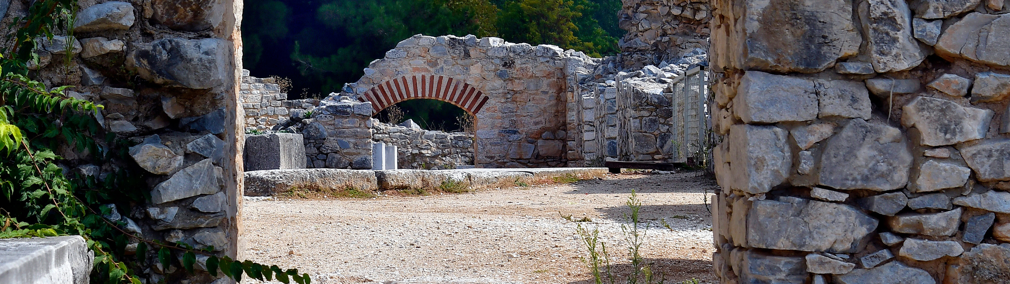
Acts 16:11-15
Notes:
So today we are focusing on Acts 16:11-15 – 5 verses no más!
Open your Bibles or your phones to Phones to Acts 16:11-15. Now don’t be tempted to look at those notifications! Go right past them to your Bible App! Let me know when you are ready by saying AMEN.

Slide 9
Acts 16:11-15
11 From Troas we put out to sea and sailed straight for Samothrace, and the next day we went on to Neapolis. 12 From there we traveled to Philippi, a Roman Colony and the leading city of that district of Macedonia. And we stayed there for several days.
Notes:
Acts 16:11-15 (Let’s read together)
11 From Troas we put out to sea and sailed straight for Samothrace (Sam-ah-thres), and the next day we went on to Neapolis. 12 From there we traveled to Philippi, a Roman colony and the leading city of that district of Macedonia. And we stayed there several days.

Slide 10
Acts 16:11-15
13 On the Sabbath we went outside the city gate to the river, where we expected to find a place of prayer. We sat down and began to speak to the women who had gathered there. 14 One of those listening was a woman from the city of Thyatria named Lydia, a dealer in purple cloth. She was a worshiper of God.
Notes:
13 On the Sabbath we went outside the city gate to the river, where we expected to find a place of prayer. We sat down and began to speak to the women who had gathered there. 14 One of those listening was a woman from the city of Thyatira (thigh-a-tie-ra) named Lydia, a dealer in purple cloth. She was a worshiper of God.

Slide 11
Acts 16:11-15
The Lord opened her heart to respond to Paul’s message. 15. When she and the members of her household were baptized, she invited us to her home. “If you consider me a believer in the Lord,” she said, “come and stay at my house.” And she persuaded us.
Notes:
The Lord opened her heart to respond to Paul’s message. 15 When she and the members of her household were baptized, she invited us to her home. “If you consider me a believer in the Lord,” she said, “come and stay at my house.” And she persuaded us.

Slide 12
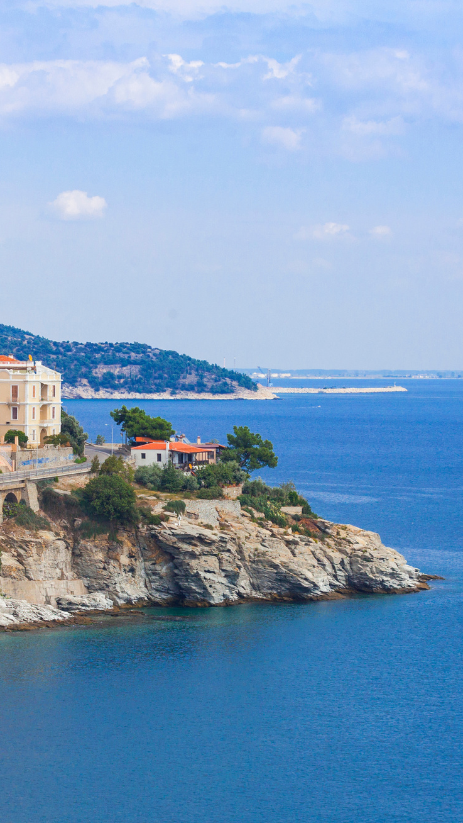
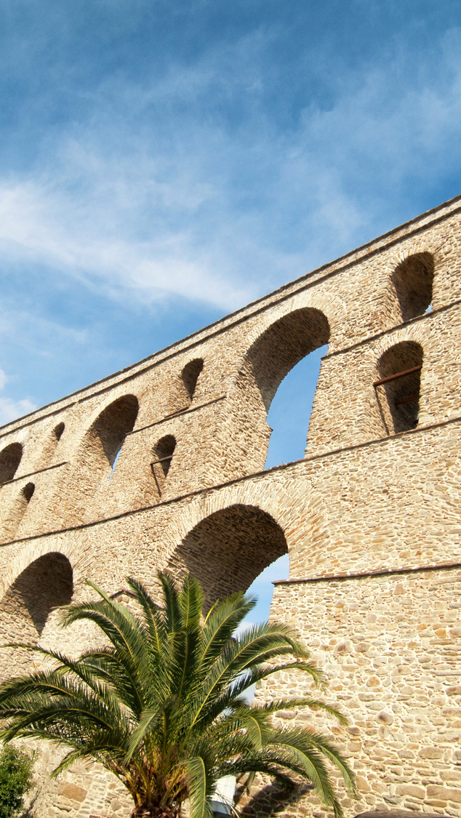
Who is the “we”?
Notes:
Let’s set the stage here.
We put out to sea.
We went on to Neapolis. (Kavala)
We traveled to Philippi.
We stayed there for several days.
Who is the “we”? Paul, Silas, Timothy, and Luke
What are these guys doing? Disciple making. Church planting.
Paul’s missionary trips can look so easy right? I mean, apart from the whippings and the shipwrecked and the prisons… reading about them can make them seem so smooth. He went here and then there and then here. We forget the human nature of this trips.
Thankfully Acts 16 gives us a behind the scenes glimpse. Did you know that this part of Acts was not in Paul’s planner?
He actually had wanted to get to Ephesus but Luke reports that the Holy Spirit prevented this. So, they switched gears and tried to go north but again “the Spirit of Jesus” opposed them.
Finally, in the port city of Troas God gives them some direction. In a dream, Paul saw a man calling out, “Come to Macedonia and help us.” So the missionary team sails across the sea to Neapolis, Kavala and hit the road ending up in Philippi.

Slide 13

Do you make plans?
Notes:
It makes me wonder; do you make plans? How does that go for you? My husband could tell you how it goes for me.
I am sure we can all think of our well-intentions or not-so-well-intentioned plans that we have made or are considering making. I feel like planning is a part of our human nature – especially in western culture. We want to know the next steps.
Has the Holy Spirit ever prevented your plans? Closing doors on you? Have you felt like you are sailing from port to port and you are just waiting for a vision from God to tell you what in the world to do next?
Friends, these are perfectly designed moments from our Lord calling us closer to Him. Asking us to trust Him and to reassess our hearts and motivations.
In college I went through a spiritual crisis. I was young, immature, passionate. I could feel the gifts God had given to me but I just didn’t see a place to use them in ministry… and I wanted to be a part of ministry. So I took control myself – forging my way and moving into spaces and opportunities where I could actually use my gifts… for the love of me, myself and I. I know this now. At the time, my rhetoric was all about service service service but my heart was about me me me.
My good Lord knew this. He opened and closed doors for me because he cares more about my heart than my works.
Our intentions matter. Our motivations matter.
God tells us that with Him nothing is impossible!
But that if we act without genuine love, love for Him, love for His people and their souls, then we are resounding gongs and clashing cymbals.
We are here because we desire to be empowered to proclaim as women in the Ministry of the Word.
What are our intentions? What are your intentions? What are my intentions?
The thing is, if hearts and minds are set on things above, our plans are there but they are not set in stone.

Slide 14
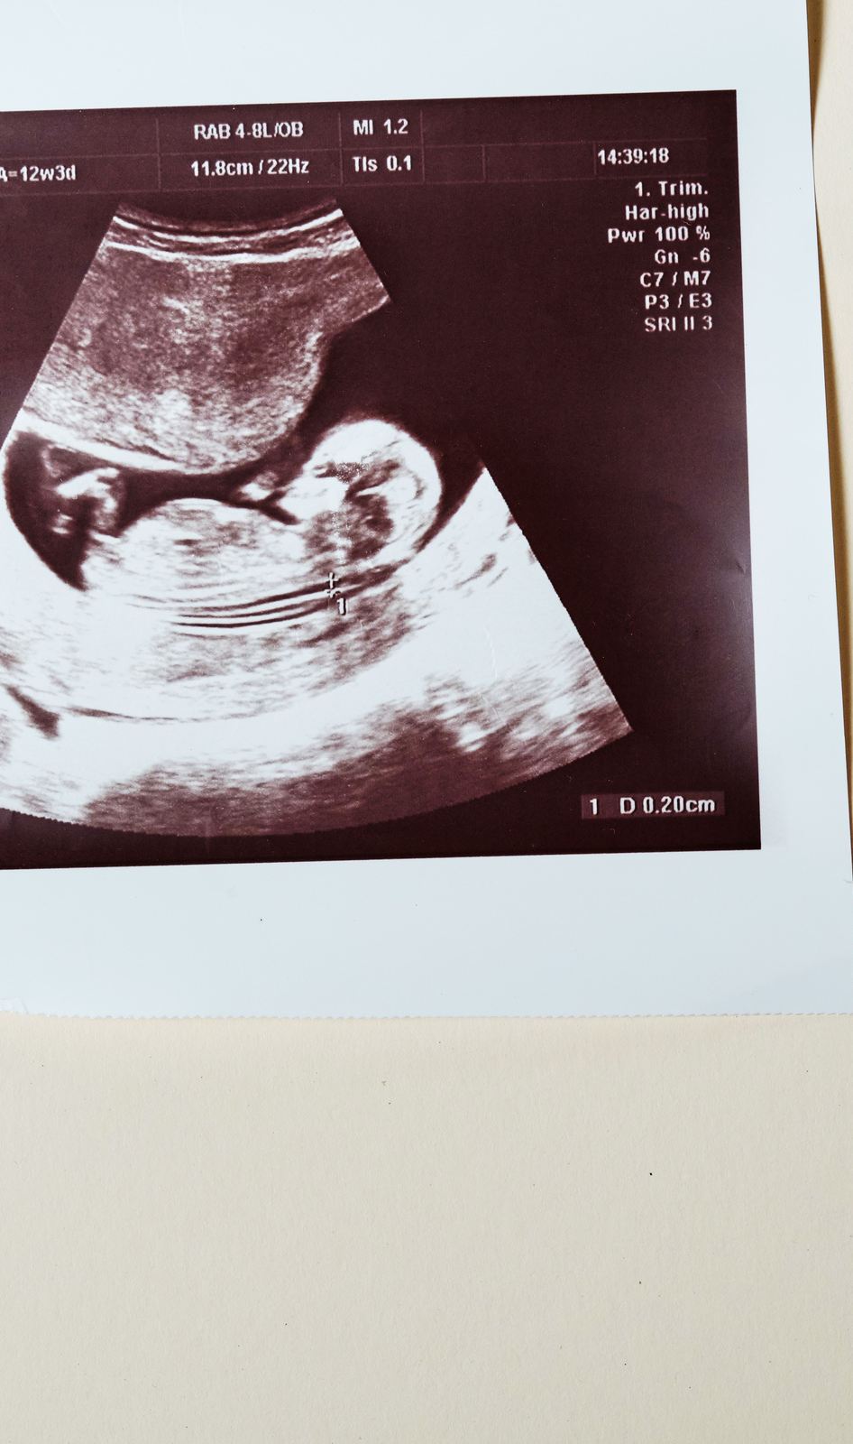
For we are God’s handiwork, created in Christ Jesus
to do good works,
which God prepared in advance for us to do.
Ephesians 2:10
Notes:
Faith is knowing that God will open and close doors as He sees fit in our lives. God will give us opportunities to serve, maybe not the ones that we envisioned but He knows more.
If God created me, knit me together in my mama’s womb, I think that He intimately knows me, what gifts to give me and what situations to put me in for the good of my soul and for the good of the church. The same is true for each of you.
God knows you.
He intimately knows your heart, desires, frustrations.
You have nothing to hide from Him.
So why not bare it all to Him and ask for His guidance.
Lord, show me. Lord, lead me. Lord, open and close doors as You see fit.
Because we truly mean it when we pray “Lord Your Kingdom Come and Your Will be Done.”
For we are God’s handiwork, created in Christ Jesus to do good works, which God prepared in advance for us to do. Ephesians 2:10. Do you believe this?
12 MIN

Slide 15
Acts 16:12-13
12 From there we traveled to Philippi, a Roman Colony and the leading city of that district of Macedonia. And we stayed there for several days. 13 On the Sabbath we went outside the city gate to the river, where we expected to find a place of prayer.
Notes:
Let’s get back to our missionaries… we only just got off the boat
Acts 16:12-13 From there we traveled to Philippi, a Roman Colony and the leading city of that district of Macedonia. And we stayed there for several days. On the Sabbath we went outside the city gate to the river, where we expected to find a place of prayer.
The team ends up in a small Roman colony.
Philippi
This is anything but a religious city.
It is a 10,000 population “little Rome away from Rome” filled with retired Roman soldiers.
Now we have evidence that this was not a religious place to be because Paul couldn’t even follow his normal routine of finding the synagogue to start his preaching. There wasn’t one. You see; in order to have a synagogue, you needed to have 10 Jewish males. There were not 10 believing Jewish males here.
So where did they go? To the river… where they expected to find a place of prayer. You see, the Jewish people had washing rituals in the ceremonial laws.
Who did Paul find there?
Women. Can you imagine what he was thinking? A MAN had spoken to him in a dream calling him to Macedonia. He is on a mission to plant churches and here he sits in a city that didn’t even have a synagogue, by a river with a group of women.
This was probably not in his church planting 101 plan.
What did they do?

Slide 16
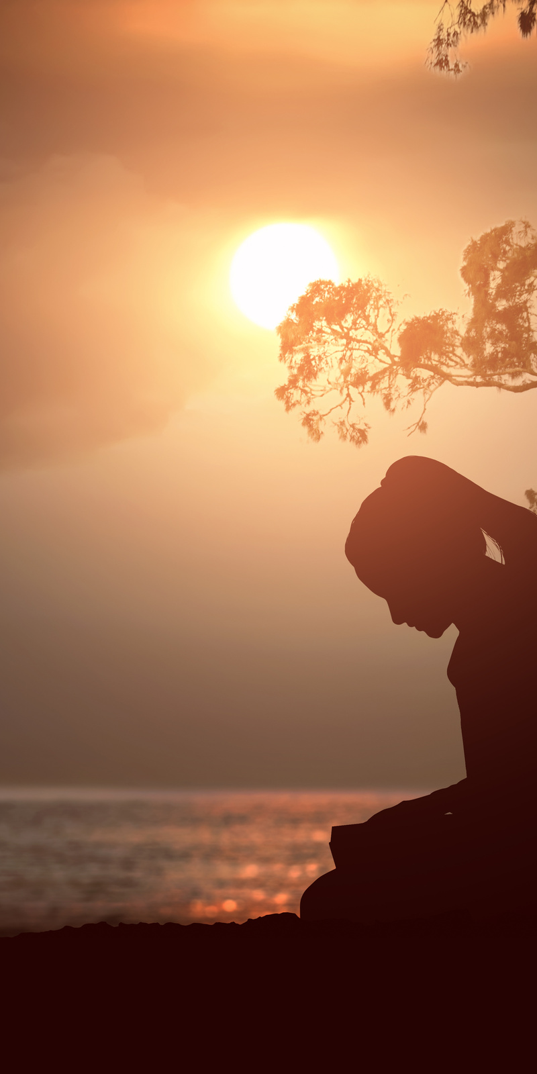
Acts 16:13
13 We sat down and began to speak to the women who had gathered there.
Notes:
Acts 16:13 We sat down and began to speak to the women who had gathered there.
Paul and the team… sat.
I want to pause here to talk about something. SEEKING THE LOST.
As a missionary kid and now as a missionary myself, I have fielded questions or have been asked to speak to “Seeking the Lost” or “reaching those who live in darkness.”
My fear here is that it may be assumed that “they” (in cultures and neighborhoods very different than ours) live in darkness and that we go “down” to them.”
My fear here is that we forget that we were once darkness too.
That darkness continues to exist in our country, in our neighborhoods, even perhaps in our homes. Of course, here the darkness we are speaking of is being literally dead in our sin, unable to wake up or to turn a light on, unable to even desire to see the light without the Holy Spirit.
My fear here is that it may be assumed that the work of a missionary is outwardly radical – moving to another country, speaking a different language, those who sacrifice comfort… when the reality is that God calls each and every one of us to be a light on a hill, and the hills that we inhabit are filled with people who are seemingly not like us on the outside.
Paul and the team had plans, I am sure.
But one Saturday, they found themselves by a river near Philippi with a group of women and they stopped, and they sat and they spoke.
They didn’t shun the group of women in a man’s world. They didn’t assume women could not be a part of their church-planting movement. Instead… they sat with those they believed were valuable souls and building blocks in the kingdom.
You have plans, but where do you find yourself right now? Could it be, that He has you exactly where He has you right now for a reason? For the souls around you?

Slide 17
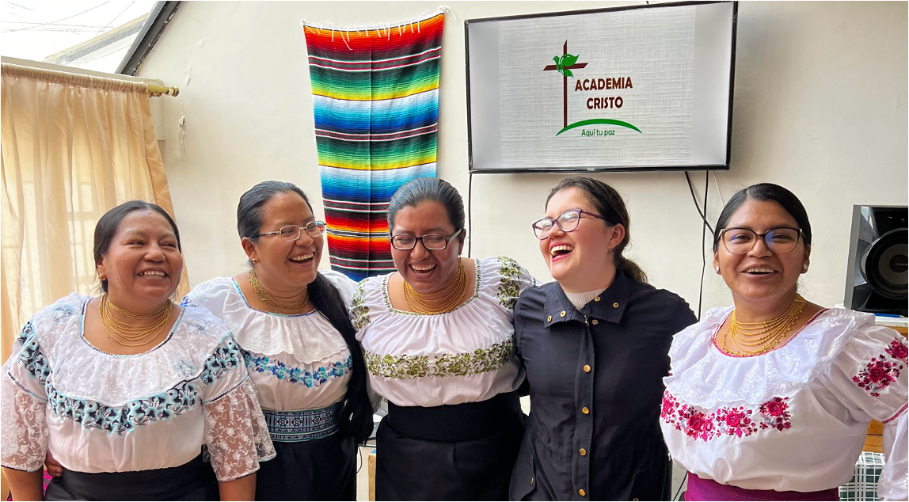
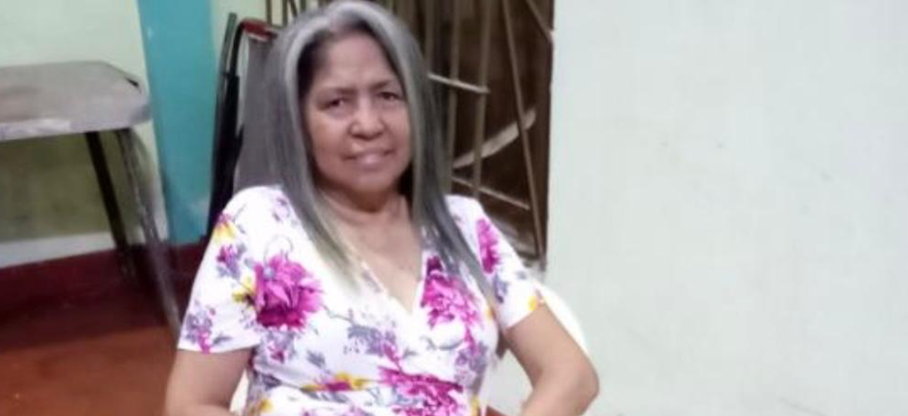
Who is around you?
20
22
Notes:
Who is around you?
Perhaps the Holy Spirit is leading you to sit and to speak with the most unexpected people.
Let’s keep our eyes open – we are empowered to proclaim!
Let’s not assume mission work is for those in other countries reaching the lost.
Let’s assume that we, who were once lost, are now in ministry right where we are.
(Stories – my women catch reach people that I or the missionaries never could, and they can do it better than us)
10 min

Slide 18
Acts 16:11-15
Sit in Scripture
Be Changed by Scripture
Notes:
We are still sitting in scripture, but now we are also transitioning to being changed by scripture.
Let’s get back to the women praying by the river…

Slide 19
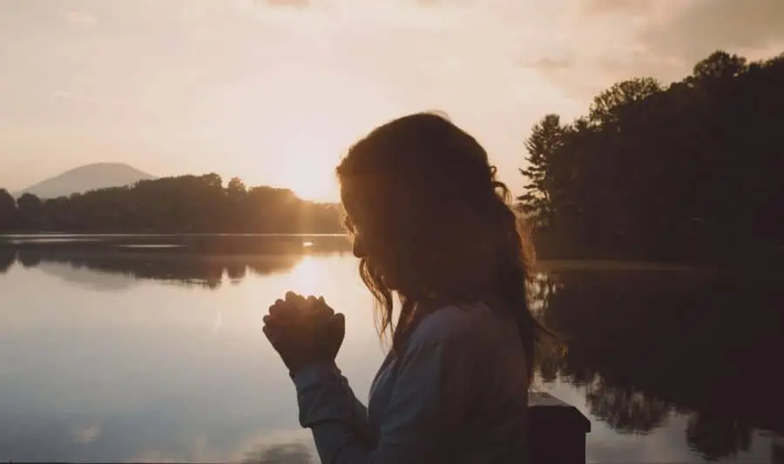
ACTS 16:14
14 One of those listening was a woman from the city of Thyatria named Lydia, a dealer in purple cloth.
Notes:
14 One of those listening was a woman from the city of Thyatira (thigh-a-tie-ra) named Lydia, a dealer in purple cloth.
I love this section for so many reasons.
The first, THE NAME LYDIA. We know her name! All of the Bible is useful… I personally think the names and specifically the names of the women hold a special meaning for us women, or at least an emotion.
Back in the day, I would roll my eyes at the women of the Bible. They were not cool enough to me. It was a maturity issue and a humility issue.
But they were cool enough to God. In this Bible story, they were cool enough for the missionary team. They were cool enough to Luke and the HS that lead him to write about these women and specifically Lydia. Lord, humble my heart to value people and to value the Words that you give me. Teach me to listen in your Word and not just to take out of it what I want to hear.
The name Lydia also holds special meaning for me because it tells me a lot about her. Lydia had moved to this city from a region that lay across the sea. The account tells us that she was originally from the city of Thyatira, which was in the region of LYDIA.
Why is this interesting? In Latin America, there is a nickname for those who come from North America or for those who look North American. They call us gringos. Gringo meaning, North American. I am “the gringa.” (Which totally rubs me the wrong way because I am not from the States but yes, I look like it.) My husband is “the red-headed gringo”. My son was born in Chile but even he is called “the gringito.”
Perhaps Lydia was called Lydia because she was from Lydia. She was a foreigner, and immigrant just like me. She didn’t belong in this Roman Colony, but she did belong in the family of God.
We know her name.

Slide 20
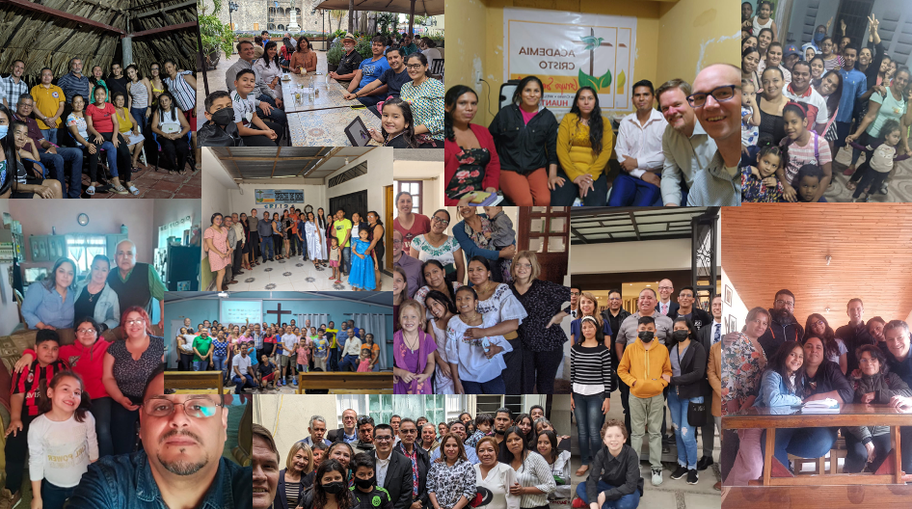
Notes:
God knows your name.
He knows the name of those I work with.
Remember how Paul and the missionary team got to Philippi? After many setbacks, various cities that God proverbially closed the entrance to, a vision, a walk north from the coast where their ship docked to this colony of non-believers to the river outside of the city gates.
That is God my friends – that is not coincidence.
That is relentless pursual from a God of insane love for one name that he knew. Lydia.
He knows your name. He pursues YOU. (Psalm 23

Slide 21
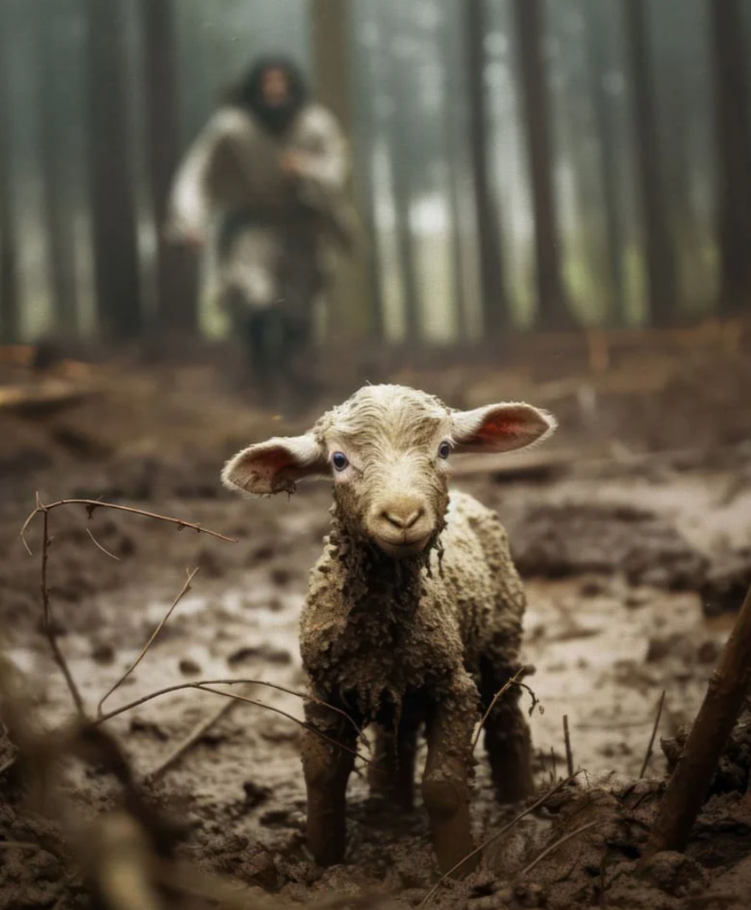
יִ֭רְדְּפוּנִי
Notes:
When you are pursued that hard… when you truly feel His pursuit of YOU.
It changes everything.
And it changes how you pursue others.

Slide 22
ACTS 16:14
14 One of those listening was a woman from the city of Thyatria named Lydia, a dealer in purple cloth. She was a worshiper of God. The Lord opened her heart to respond to Paul’s message.
Notes:
Luke tells us that Lydia was a worshiper of God. I mean, she was by the river on the Sabbath to pray. She knew God, but she did not know her Savior. She was still in darkness.
In Latin America, many people “know God.” I believe this is true in the United States as well.
God is unapproachable. One must go through others to get to him. In LA this looks like saints or processions. Ultimately the peace of God is through someone other than God.
God is unachieveablle. How many believe that they have to clean themselves up in order to be a member of God’s family?
God is a feeling.
God is Spirit.
“God is there, but I don’t want him.”
What is our response?

Slide 23

Jesus sat. Paul sat.
Notes:
Jesus sat. He didn’t practice a separatist ministry. Do you remember the type of people he sat with?
Paul sat.
Lydia “knew God.” Luke tells us that she was a worshiper of God. But Lydia did not “know God.” She did not know the saving work of Jesus.
Luke also tells that the Lord opened her heart to respond to Paul’s message. We don’t know what sermon Paul shared with Lydia and the women that day, but we do know that is was filled with the Gospel – we have proof of this, in Lydia’s response.

Slide 24
Acts 16:14
The Lord opened her heart to respond to Paul’s message.
Notes:
Luke records that “The Lord opened her heart to respond to Paul’s message.

Slide 25
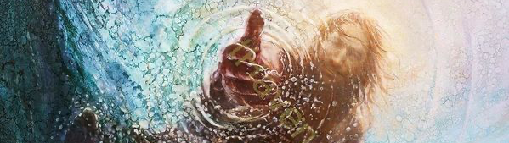
Saved.
Notes:
I am standing her today, speaking to a room of believers, of women so active in their faith that they dedicated time and resources to come to this conference! Conversion is no surprise to you.
We sing “I was sinking deep in sin, far from the peaceful shore..”
And “Amazing grace how sweet the sound, that saved a wretch like me.”
Our conversion is a part of our regular conversation. But I wonder if we sometimes forget the miracle of what this actually means. I wonder if our forgetfulness impacts how we view those around us.
How we view Lydia.
Yikes, how we view God.
Paul understood this. Remember his conversion? Christian murderer to apostle.

Slide 26
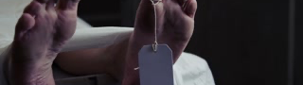
Darkness to life.
Notes:
I think this is why He could describe conversion so well for us in Ephesians 2 –
We were dead in our sins and following the way of the world and the ruler of the kingdom of the air, gratifying the cravings of our flesh and following its desires and thoughts.
A dead person cannot decide to breathe. A dead person cannot decide to care about God. A dead person under the Devil actually has no desire to have anything to do with God. This is the nature of a human before touched by God – we should not be surprised with the people we interact with who do not know God yet.
“But because of His great love for us, God, who is rich in mercy, made us alive with Christ even when we were dead in transgressions” Ephesians 2:4-5
Friend, do you realize that you are a living, breathing miracle? Your conversion story makes evangelism possible on so many levels. But one special element of your conversion is that now you possess a unique empathy for others.

Slide 27
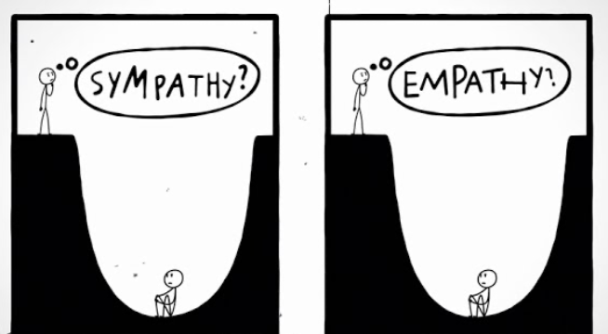
Notes:
Do you know what empathy is? It is not looking into a pit and sayings “you got this” or even throwing a rope down from the top. It is climbing down into the pit to be with another person.
Because of your conversion you are not surprised by sinful human nature… you know what dead in sins is either because you lived it or because God has told you. The more you remember your conversion – the easier it becomes to sit with others.
GRACE CHANGES EVERYTHING. Grace changes us.

Slide 28
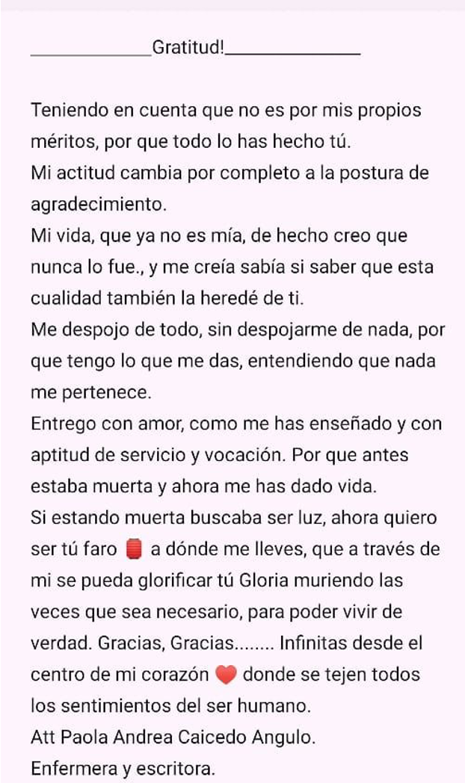
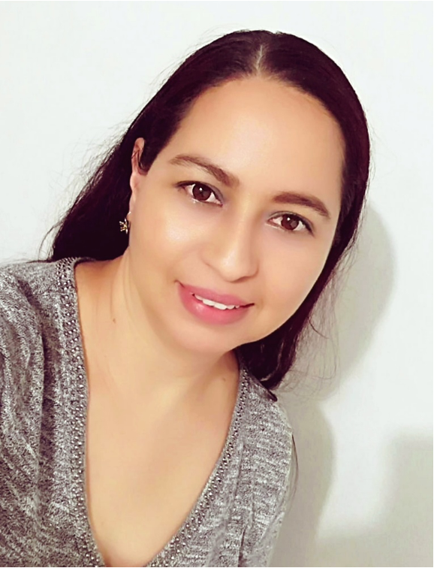
Notes:
Permit me to introduce you to a modern-day Lydia: Paola
Gratitud por Paola / Gratitude by Paola
Teniendo en cuenta que no es por mis propios méritos, por que todo lo has hecho Tú. Mi actitud cambia por completo a la postura de agradecimiento.
Taking into account that it is not because of my own merits, because You have done everything, my attitude completely changes to a posture of gratitude.
Mi vida, que ya no es mía, de hecho creo que nunca lo fue, y me creía sabía si saber que esta cualidad también la heredé ti Ti.
My life, is no longer mine, in fact I believe it never was. I thought I knew, but to know is a quality that that I also inherited from You.
Me despojo de todo, sin despojarme de nada, por que tengo lo que me das, entendiendo que nada me pertenece.
I strip myself of everything, without stripping myself of anything, because I have what you give me, nothing is mine.
Entrego con amor, como me has enseñado y con aptitud de servicio y vocación. Porque antes estaba muerta y ahora me has dado vida. I give with love, as you have taught me and with an aptitude for service and vocation. Because before I was dead and now you have given me life.
Si estando muerta buscaba ser luz, ahora quiero ser tú faro. A dónde me lleves, que a través de mi se pueda glorificar tú Gloria muriendo las veces que sea necesario, para poder vivir de verdad. If when I was dead I sought to be a light, now I want to be your lighthouse. Wherever you take me, may your Glory be glorified through me by dying as many times as necessary to be able to truly live.
Gracias, Gracias… infinitas desde el centro de mi corazón. Donde se tejen todos los sentimientos del ser humano. Thank you, Thank you… infinite thank yous from the center of my heart where all the feelings of the human being are woven.
Paola is a woman like you and me. Face to face with her Lord, she does not sit in fear. She does not question her place in the Kingdom or in sharing the Word. Instead of analyzing her place in ministry, she is living ministry right where God has already placed her. Encountered by grace, Paola now writes and publishes about her Lord. She shares her faith with her patients.
Friend, grace changes you.
Trust the process.

Slide 29
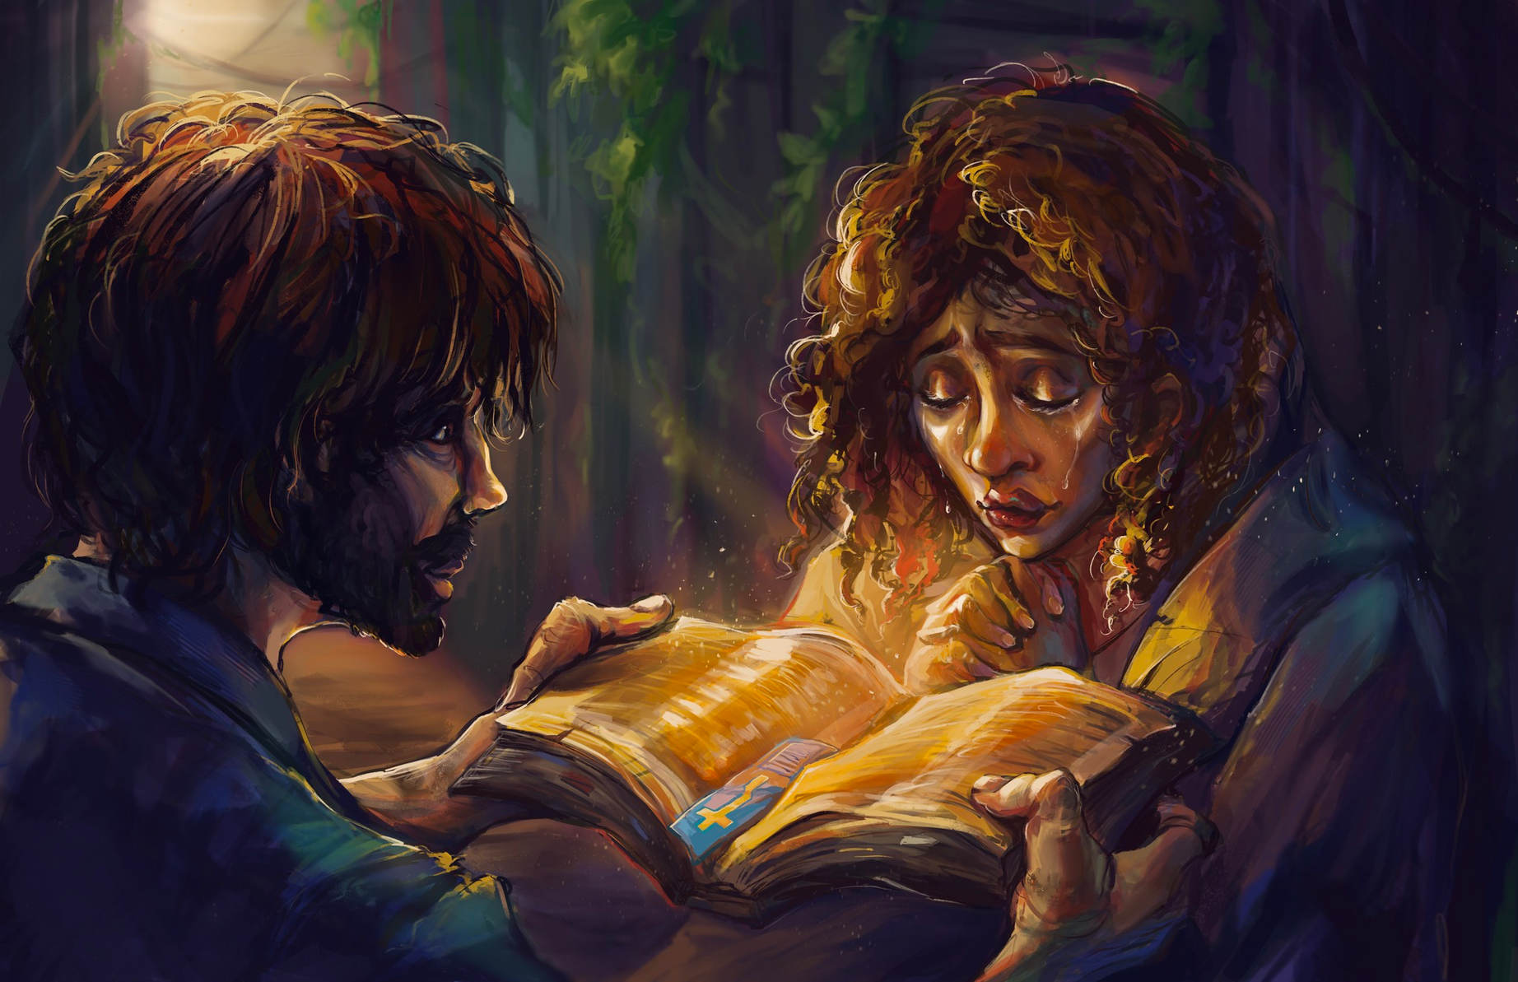
Acts 1:8
You will receive power when the Holy Spirit comes on you; and you will be my witnesses in Jerusalem, and in Judea and in Samaria, and to the ends of the earth.
Notes:
Vienne Laing Luther Preparatory School Trinity, Belle Plaine, MN
CHANGED BY SCRIPTURE
Culture might tell us that this looks like a perfectly curated bible time. Speaking on a stage. An official ministry position. Our due diligence in our spiritual life led by self-help books.
The Bible tells us that the only tool we need are the sacraments – arrow down opportunities where God pours down on us his grace. The Word is living and breathing. Baptism. Communion.
Acts 1:8 You will receive power when the Holy Spirit comes on you; and you will be my witnesses in Jerusalem, and in Judea and in Samaria, and to the ends of the earth.

Slide 30
Acts 16:11-15
Sit in Scripture
Be Changed by Scripture
Move because of Scripture
Notes:
MOVE BECAUSE OF SCRIPTURE

Slide 31
Acts 16:15
15. When she and the members of her household were baptized, she invited us to her home. “If you consider me a believer in the Lord,” she said, “come and stay at my house.” And she persuaded us.
Notes:
ACTS 16:15
The Lord opened her heart to respond to Paul’s message. 15 When she and the members of her household were baptized, she invited us to her home. “If you consider me a believer in the Lord,” she said, “come and stay at my house.” And she persuaded us.
Lydia was baptized. She led her family to be baptized as well. Children? Servants? Not the point – her faith immediately influenced those that she did life with.

Slide 32

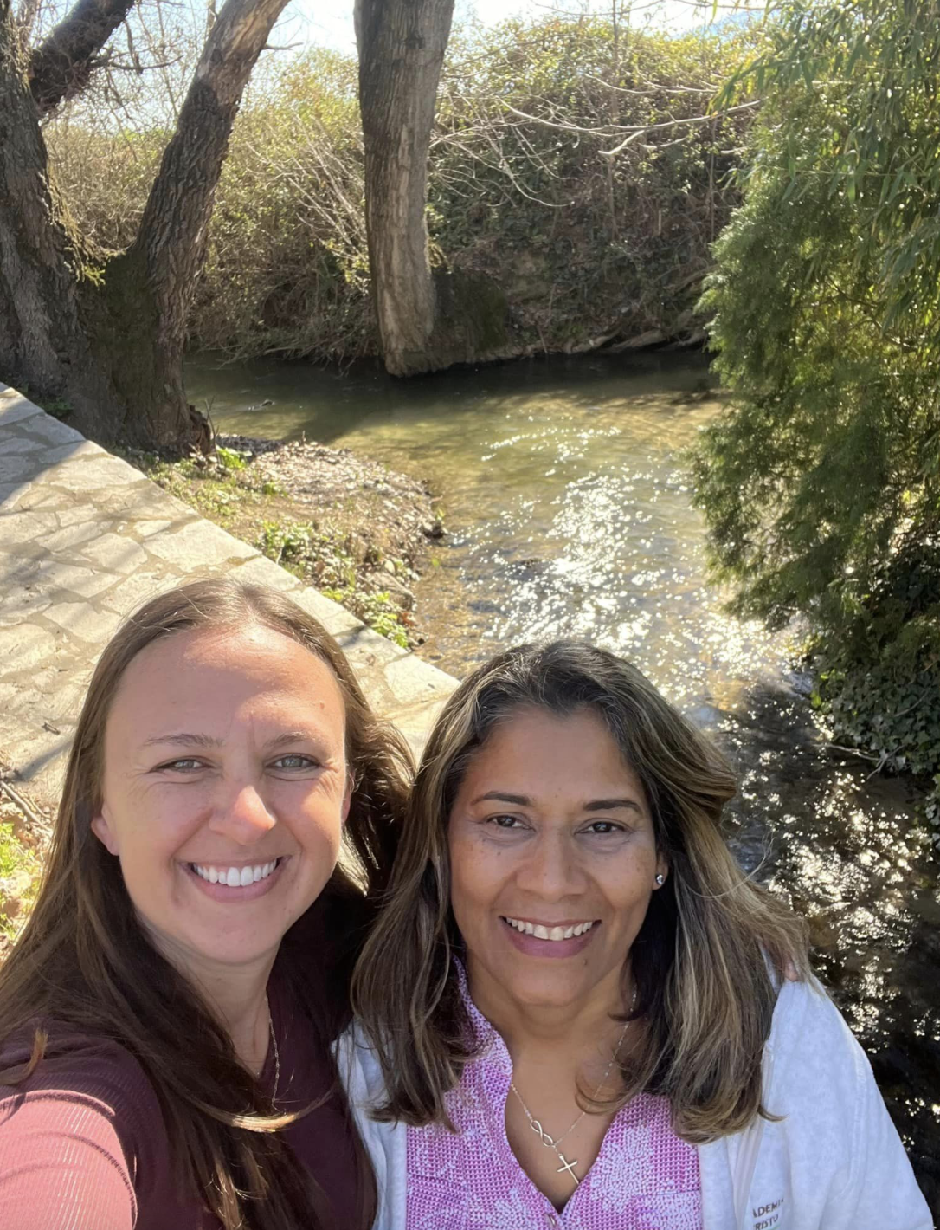
Who do you do life with?
Notes:
Who do you do life with? Who do you speak with on a weekly basis?
You currently live in a very specific context – like the women that I get to work with in Latin America.
Young. Old. Single. Spiritually Single. Married. Widowed. Separated. Divorced. Aunt. Grandma. Mom. Past mom. Worker. Student. Sick. Abused. Strong. Weak.
There is a thread that runs through all of the women of the Bible and through each and every one of us. From Eve, to Sarah, to Hagar, To Leah, to Huldah, to Rahab to Mary to Priscila to you and to me.
Different contexts. Same cross.
Different mountains and valleys. Same tomb.
Different strengths and weakness. Same holes in His hands.
Who do you do life with? Who do you intimately know… not only by blood but because of your experiences? Have you considered that you can do ministry to them much better and more effectively than me, or your local pastor? Have you considered the ministry that you can do in personal conversations?
We are empowered to proclaim. Each and every one of us.

Slide 33
Acts 16:15
“If you consider me a believer in the Lord,”
she said,
“come and stay at my house.”
And she persuaded us.
Notes:
Baptized. Changed. Lydia invited Paul and his companions to her home. “If you consider me a believer in the Lord,” she said, “come and stay at my house.” And she persuaded us.
Lydia insisted. “And she persuaded us.”
I learned from Mission Luke Wolfgram something cool about Lydia’s persuasion. The verb “persuaded” is used only one other time in the NT, in Luke 24.

Slide 34
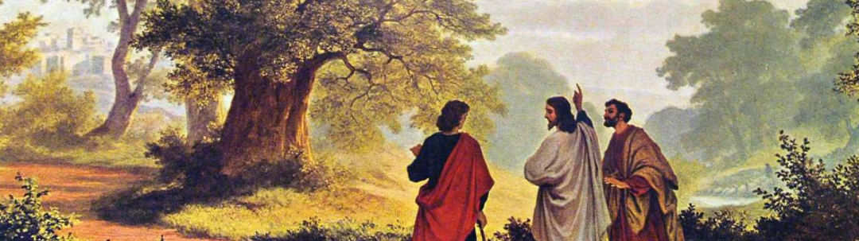
Come and stay.
Notes:
Do you know what happened in Luke 24?
Two men were walking to Emmaus. They were sad, confused, afraid. They didn’t know what to do. A man joined them, but their eyes were closed, they didn’t recognize him. Eventually he spoke, opening the scripture to them. He kindled a fire of hope and joy and warmed their hearts. Too quickly they arrived at Emmaus and the sermon ended. So the men persuaded him – stay with us!!! Be our guest!
This is exactly what happened with Lydia. This is the change that the gospel produces in us.
God has opened our hearts to see and believe.
Were not our hearts burning within us while he talked with us on the road and opened the scripture to us?

Slide 35
Come and stay.
Notes:
Lydia opened her home. They had just met, but now they were not strangers. They were blood relatives, bought with the blood of Christ.
She said - Come and stay.
And not just on this day – but it seems for the rest of her life. Lydia’s home was to become the center of Christian operations in Philippi, where there was worship, prayer, study, fellowship.
Paul would eventually write a letter to this congregation in a Roman Colony where originally woman prayed by the river – we have access to this letter today – the book of Philippians.
It is also easy to imagine her influence, due to her expertise in business in purple cloth, in the generous offerings the congregation sent to Paul again and again (Philippians 4:16) in Thessalonica and Corinth.
At the end of the letter to the Philippians – Paul thanked them for the gift he received from them while in chains in Rome. (Philippians 4:18). This was 10 years later!
Lydia’s life was forever changed. God sought her by the river and used Paul to share life-giving words with her. Who is God seeking through you?

Slide 36

Notes:
We too are invited to say Come and stay to those around us.
The Great Commission tells us to go and to make disciples. It also commands us to teach them to obey what he has commanded.
Think of the teaching that happens in community. Think of the nurturing environment of a living room or dining table.

Slide 37
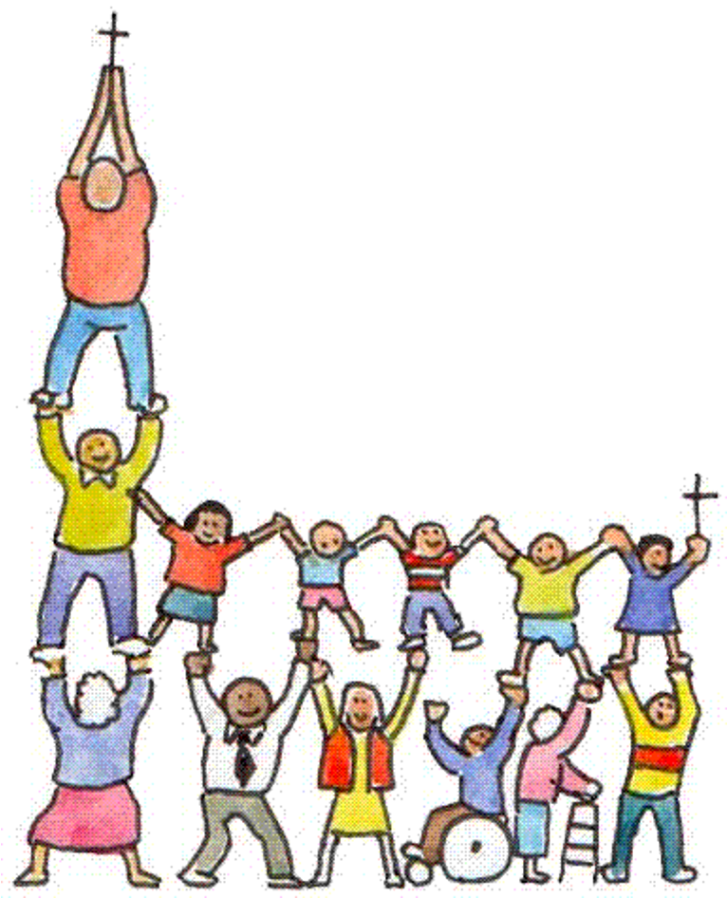
The church.
Notes:
I wonder if sometimes we forget what the church truly is?
The story of Lydia is one of many stories in Acts of God building his church: Christians gathered around Word and sacrament. Christians forever changed and who just cannot stay silent, but they live out that passage in 1 Peter that we examined before – proclaiming the goodness of him who called us out of darkness into his marvelous light.
This is the church.
Now we don’t know much about how the church in Philippi grew.
Lydia was not a Pastor. Women are not called to be pastors and we trust that the God who knit us together in our mother’s womb, the God who created men and women, that he knows what is best in His kingdom. If you have a pastor, thank God for your pastor. If you have elders, if you have headship in your worship circle and/or in your home, thank God!
But headship does not cancel out the existence of women in the church and their role in the Great Commission. A church is not made up of only pastors. The body is not made up of only the head. Women too are a valuable part of the church.
Men are called to be heads in the church. Women are called to be part of the Great Commission and Royal Priesthood. These are two truths that do not cancel each other out.

Slide 38
Notes:
Paul was not wishy washy on the roles of men and women. His letters to Timothy and the church in Corinth are our go-tos when we study the headship principle!
But Paul was also not afraid of women in ministry. We see this in his descriptions of women in the early church. I especially love the last chapter of Romans and Acts to see a snapshot of the women whom Paul esteemed as partners in ministry.
In the case of Philippi… Even after he received the vision of the man from Macedonia, he did not turn away from the women he found at the river because there was no Pastor there to lead them. He shared God’s Word, left Luke and Timothy in Philippi for a while to train the new small body of believers and trusted God to build the church.
Paul shared the Good News and trusted God to build His church. In Philippi, the Lord of the church used an exorcism, an impromptu trial ending in a beating, an imprisonment, an earthquake, and finally a near suicide to bring a male leader into the fold. By the time Paul wrote his letter to the same group he addressed the Philippian church in general “together with the overseers and deacons.”
We trust God to build his church. And we seek to be active parts of His church in ways that please him. We do not in all cases know how God will do this but we also do not shrink back from clear teaching on the headship principle NOR from encouraging modern day Lydias and “down by the river” gatherings, encouraging the gospel to be shared and waiting to see what the Lord of the Church might have in mind.

Slide 39
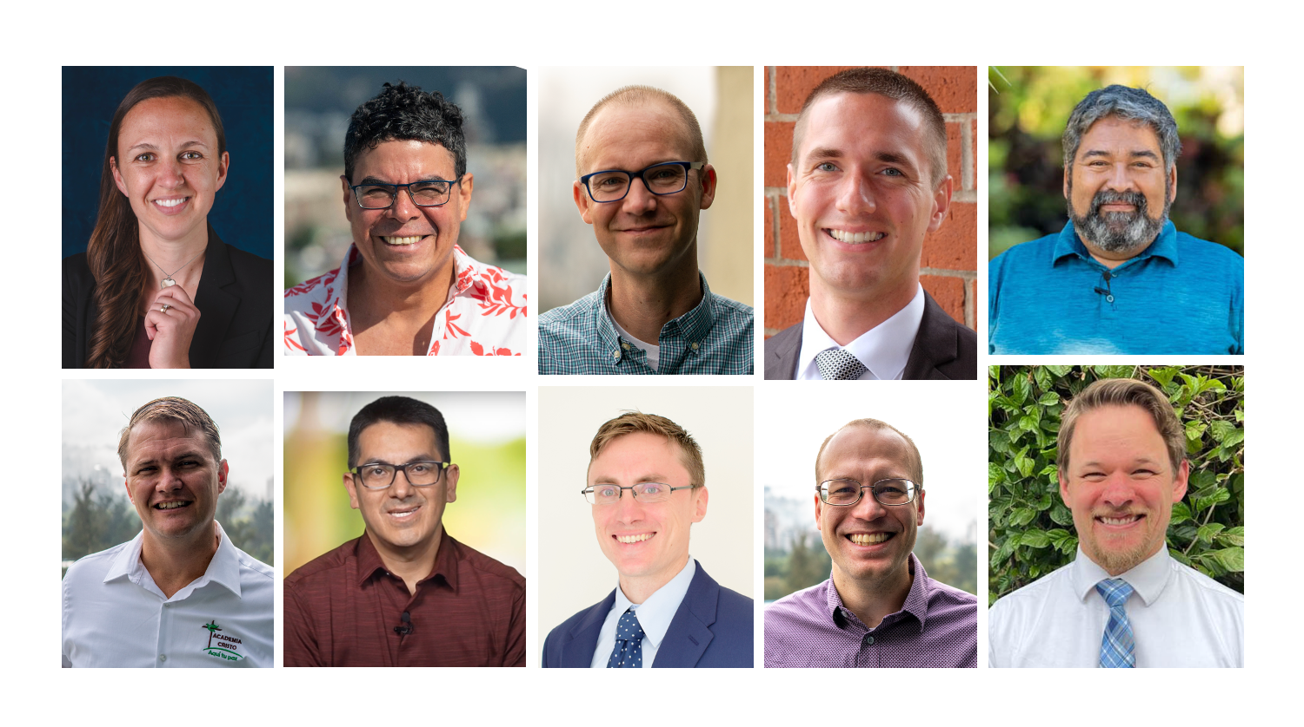
Notes:
I believe that this happens when we are not afraid.
This is my ministry. This is my call.
How does it work?
Conversations. Partnership.
Mr. Christian – are you showing humble Christ-like headship? Giving your life for the good of the church?
Ms. Christian – are you showing humble service to those around you like the church to Christ?
This picture is not to show a position – I am very well aware of how rare my position is. This picture is to share what the principle of headship looks like in action.
This can look less professional – husband. Dad.

Slide 40
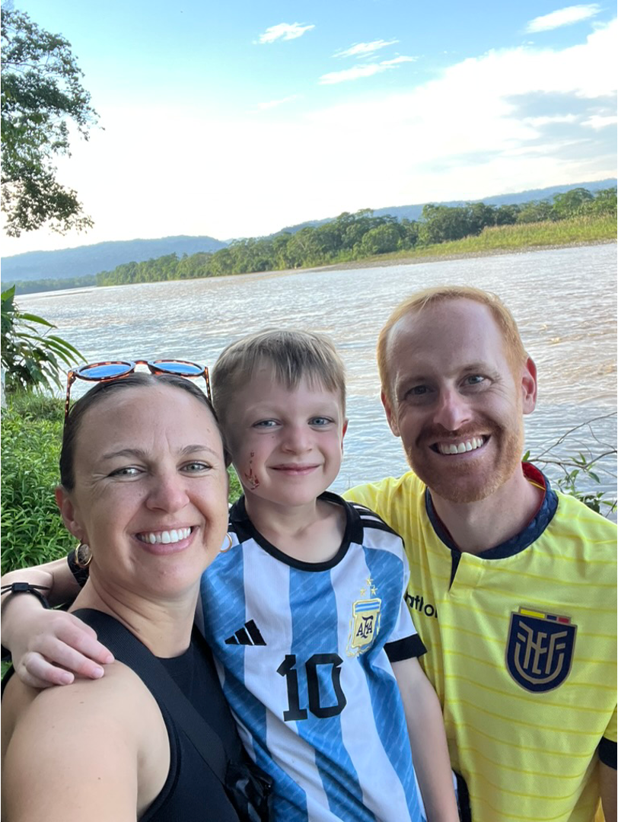
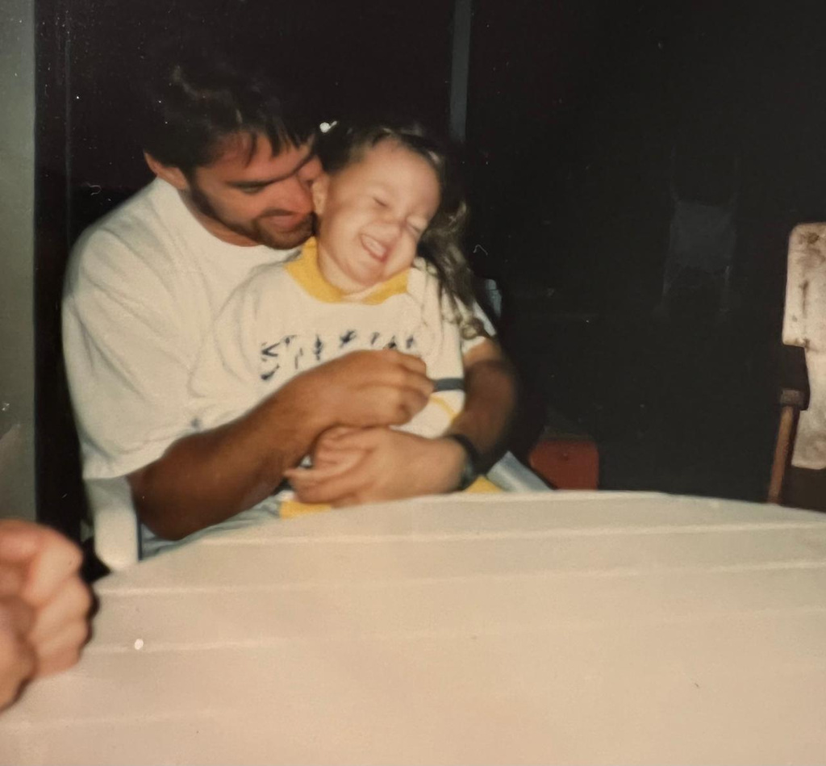
Notes:
This can look less professional – husband. Dad.

Slide 41
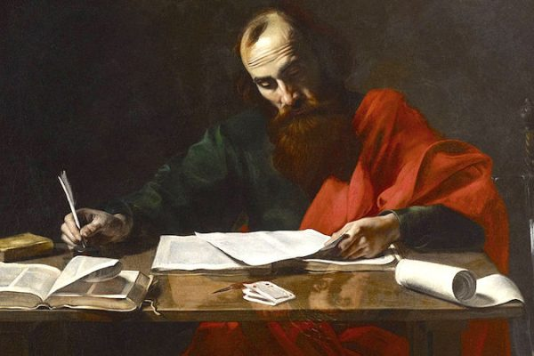
Notes:
CHANGED BY SCRIPTURE
Paul 10 years in Troas
Prayer – Lord make me a woman of the word, an actual woman of the Word. God is in it for the long run – don’t expect immediate and perfect change how you envision change to look.

Slide 42
Acts 16:11-15
Sit in Scripture
Be Changed by Scripture
Move because of Scripture
Notes:
Do you desire to be an active member of the church? Return to the tiny story of Lydia to remember just who you are and just who God is.
We are quite literally NOTHING without God. Dead. Any inking of faith or desire to do good comes from the HS. He creates the will and desire in us.
This reality humbles us in the best way possible. We don’t begrudedly go to church or open our bibles… we run to the Word fully believing in what it actually is – the source of life and nourishment for any good we could possibly do. It transforms us.
And it in process, it teaches us to settle our little hearts down and to trust that the Lord of the Church knows what is best. It silences us and emboldens us. It calms us and empowered us. It guides us. Gives us discernment.
It reminds us over and over again that We are the church only because Christ breathed life into us.
It reminds us that Christ builds His church. Suddenly our focus is not on what I Elise want to do… it is on the opportunities and people that God puts in my path because His will is good and perfect.

Slide 43
Come to me, all you who are weary and burdened, and I will give you rest.
Matthew 11:28
Notes:
Are you frustrated? Are you excited?
Are you afraid? Are you bold?
Are you tired? Are you energized?
Talk about it… with your Lord. Cast these genuine feelings on Him.
Hold the story of Lydia in your pocket and take it out regularly. It is 5 verses that represent the work of the HS in the church then and now.
Lydia didn’t know all things, but after a conversation by a river she knew her Savior and immediately invited others to know Him as well.
You don’t need a seminary education to be faithful. What do you know about God right now? Faithful. Savior. King. Good Lord… share that.
The people we interact with will not believe because we are good teachers. We show people Jesus and they believe because the saw Him and heard His Words.
“Come to me, all you who are weary and burdened, and I will give you rest.” Matthew 11:28
Come and stay.

Slide 44
COME AND STAY
Notes:
Come and stay

